Slide 1
PRODUCED IN PARTNERSHIP BY:

Slide 2
History of Vaccines
1955: Polio vaccine
1886: Typhoid vaccine
1926: Discovery of aluminum salt as adjuvant
1967: Mumps vaccine
1855: MA passes first US law mandating vaccination for schoolkids
1995: Varicella zoster vaccine
1891: Glycerin used to reduce germs in vaccines
1969: Rubella vaccine
1798: Smallpox vaccine
1926/1927 Pertussis & Tb vaccines
1935: Yellow fever vaccine
2006: HPV & shingles vaccines
1970: Anthrax vaccine
1977: Pneumonia vaccine
1800
1850
1900
1950
2000
1813: Congress creates National Vaccine Agency
1896: Cholera vaccine
1923: Diphtheria vaccine
1936: Influenza vaccine
1963: Measles vaccine
1999: Rotovirus vaccine
1974: Meningitis vaccine
1885: Rabies vaccine
1924: Tetanus vaccine
1981/1986: Hep B & Hep A vaccines
*Note that this timeline is abbreviated to give an overview of vaccine development and the recent explosion of discovery

Slide 3
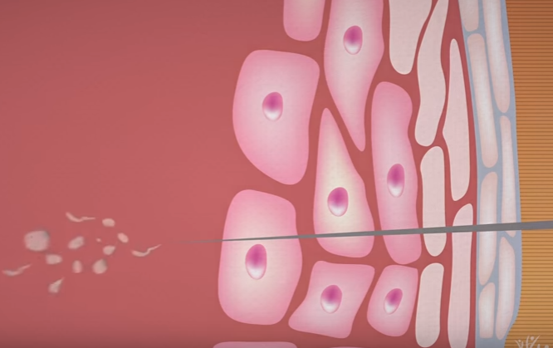
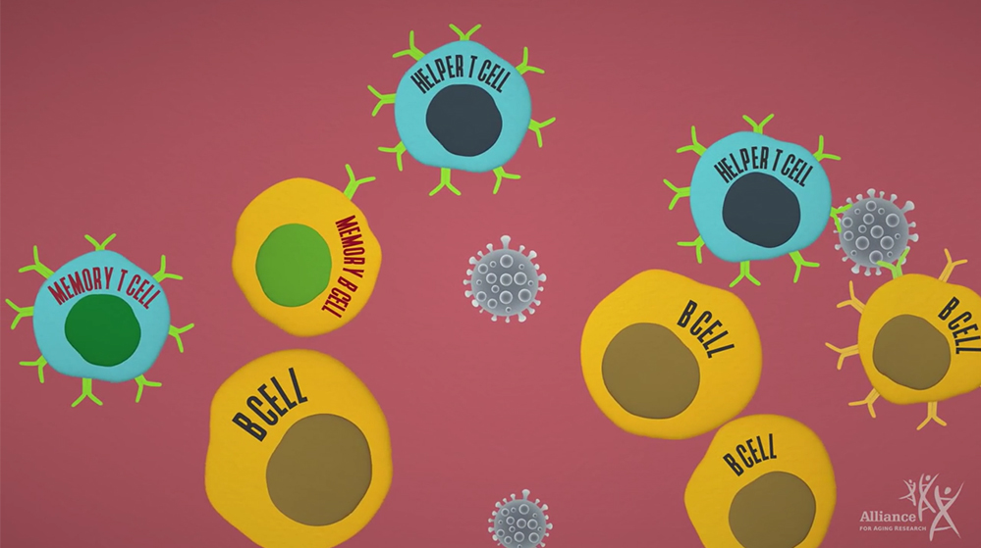
How Vaccines Work
Vaccines help us develop immunity by imitating an infection and triggering antibodies to develop Those antibodies will be available to fight the next time you are exposed to that virus or bacteria

Slide 4
Vaccine-Preventable Diseases

Slide 5
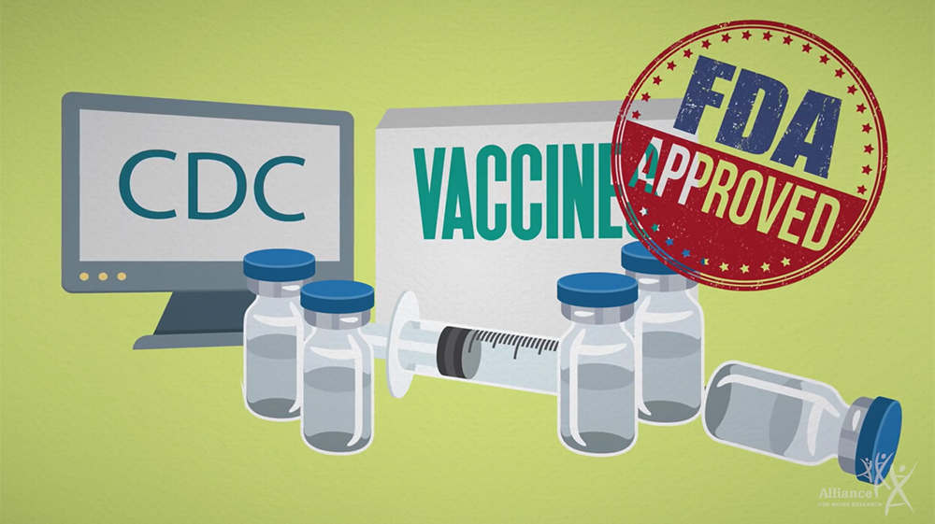
Vaccine Safety
Vaccines are safe: They have been tested by the FDA and are monitored by the CDC when in use

Slide 6
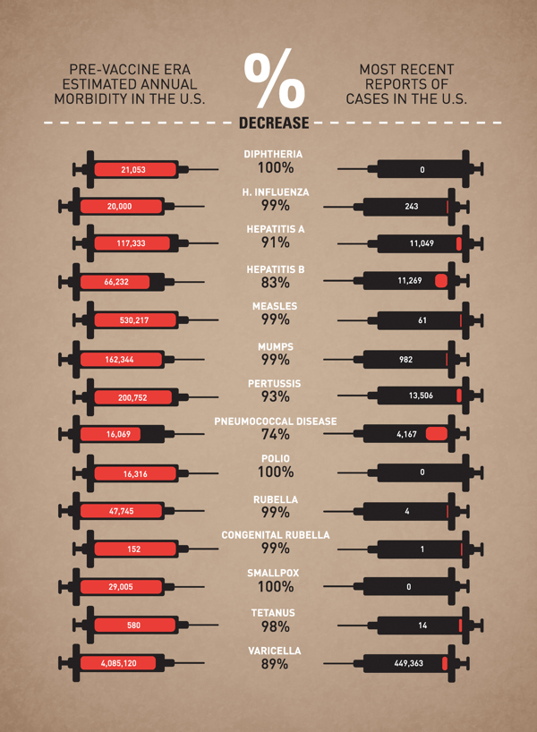
Vaccine Effectiveness
Graphic created by Leon Farrant based on CDC data

Slide 7
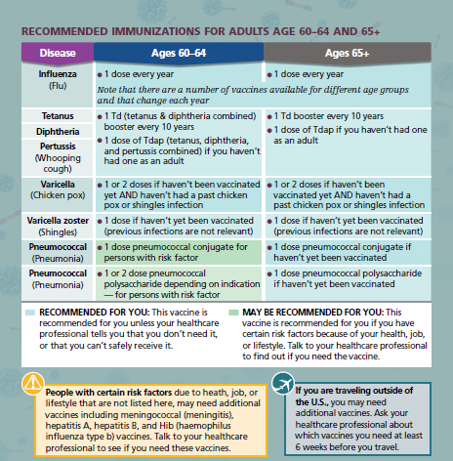
Choosing the Right Vaccines

Slide 8
Where to Get Vaccinated

Slide 9
Paying for Vaccines

Slide 10
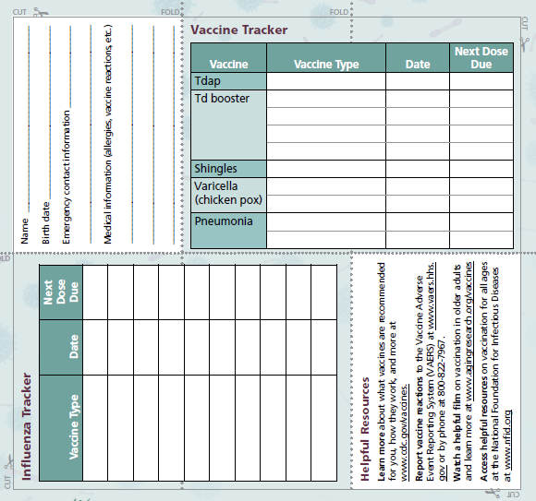
Keeping Track of Your Vaccinations

Slide 11
Thank you!
Please be sure to fill out the participant evaluation form, and return it to the workshop leader.
For questions/comments contact:
The Alliance for Aging Research
202-293-2856
info@agingresearch.org

