Slide 3
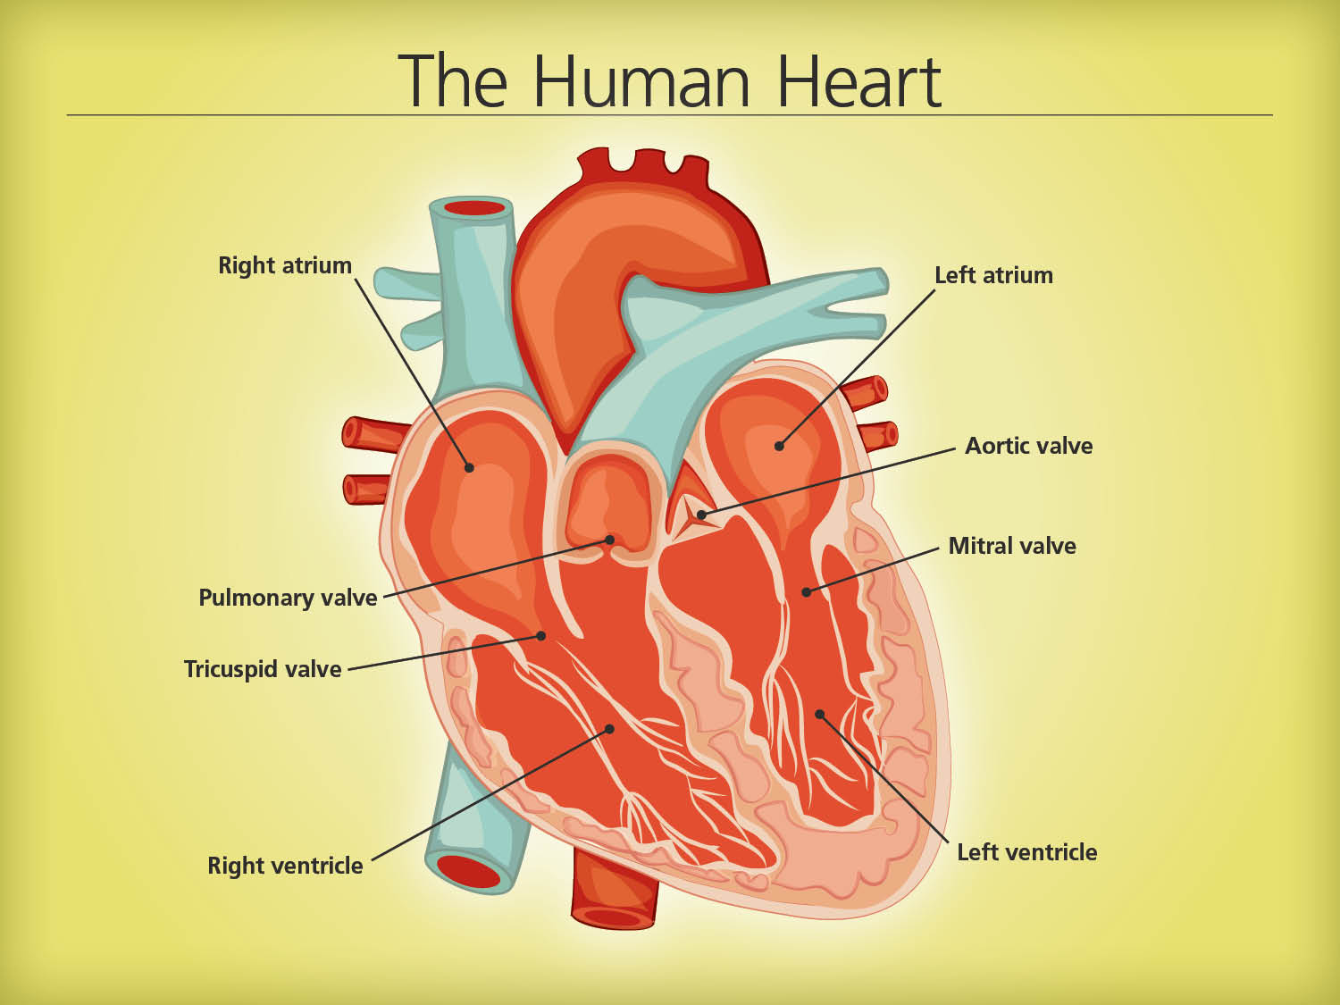

Slide 4
Will pull from video

Slide 5
Will pull from video

