Slide 1
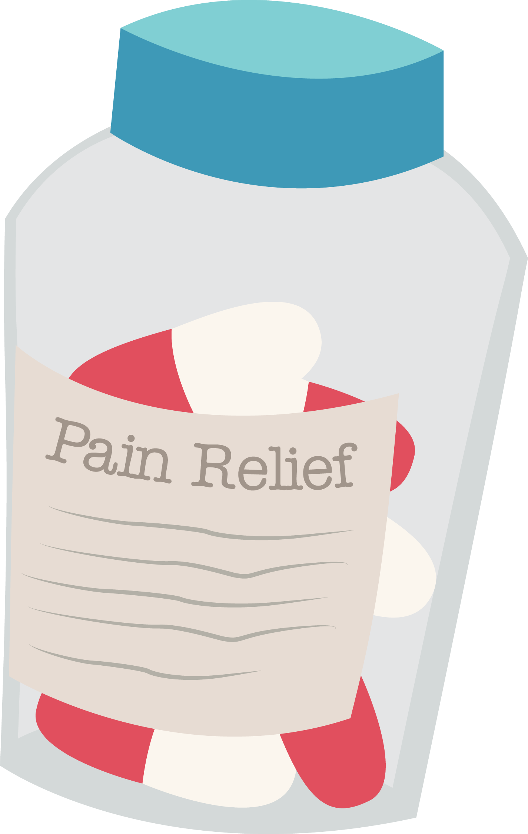

Slide 2
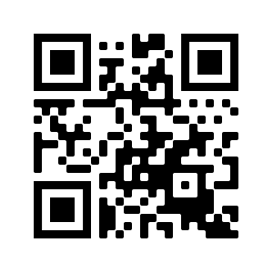
Participant Pre-Survey
Thank you for taking the pre-survey!
Your answers will help in future education about medication safety.
bit.ly/painworkshop1

Slide 3
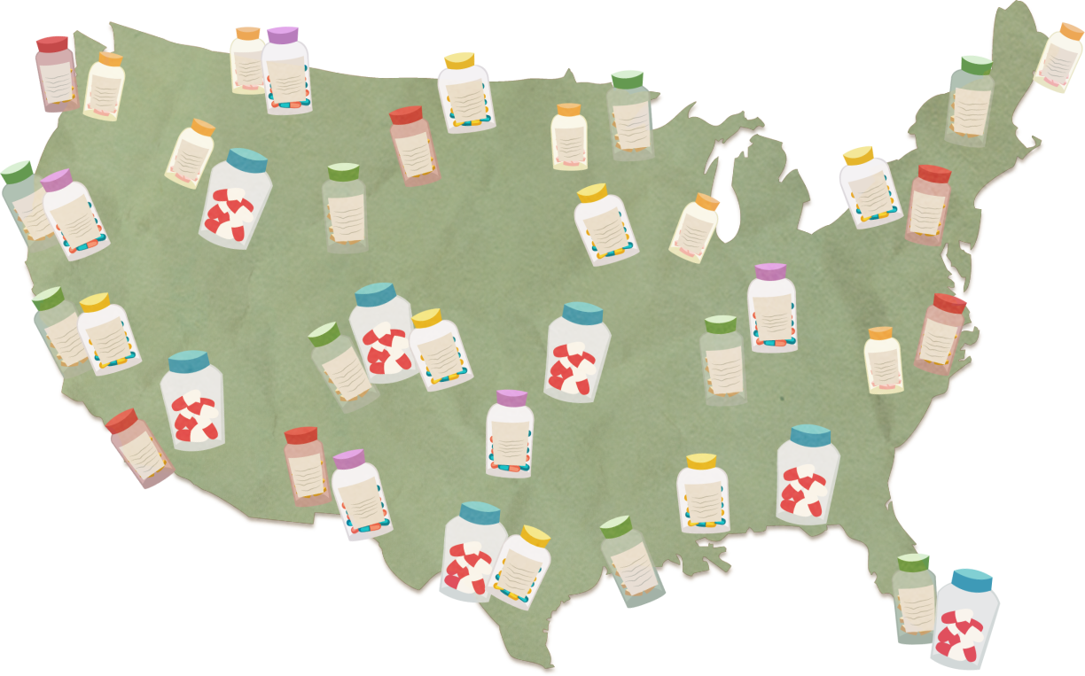
Before You Reach for Pain Relief
Pain can be acute or persistent:
Acute Pain
Has a sudden onset
Can be severe, but lasts for a short period of time—from hours to days, but no longer than six months
Can be caused by injury, illness, or surgery
Persistent (Chronic) Pain
Ongoing or recurrent pain that lasts beyond the usual course of acute illness or injury—several months to many years
Can be mild to severe, complex to manage and caused by injury, arthritis, cancer, and other diseases
Can cause physical distress and seriously impact quality of life

Slide 4
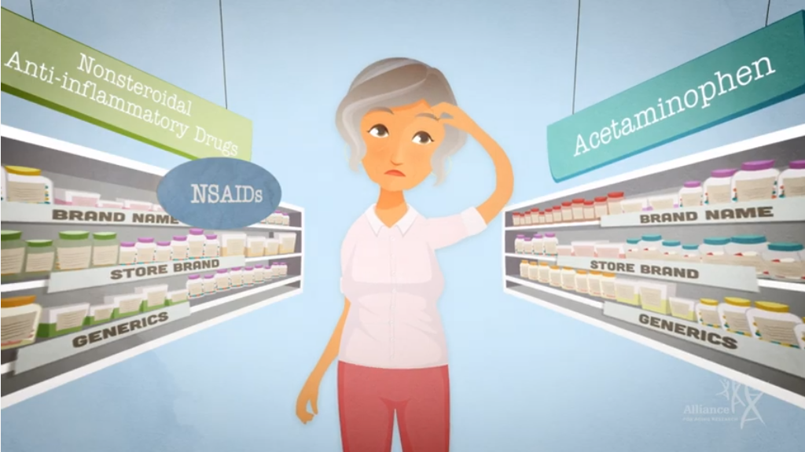
Medications Have Different Risks & Benefits

Slide 5
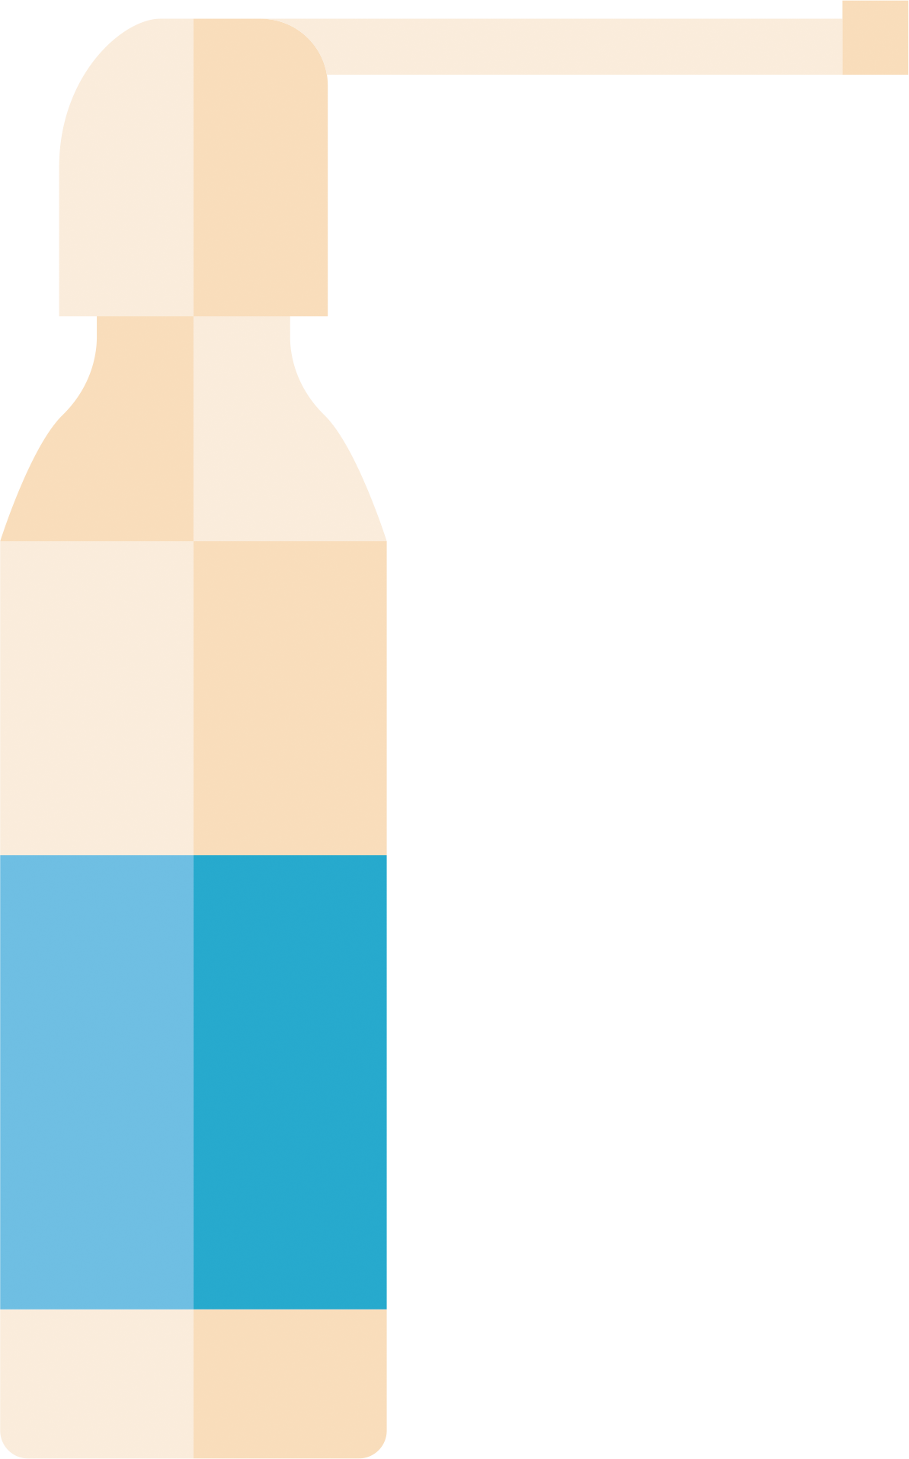
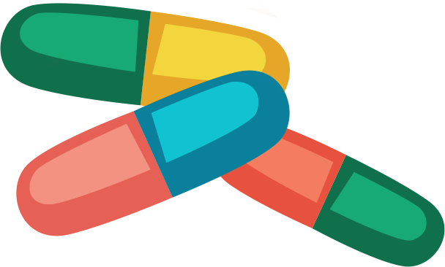
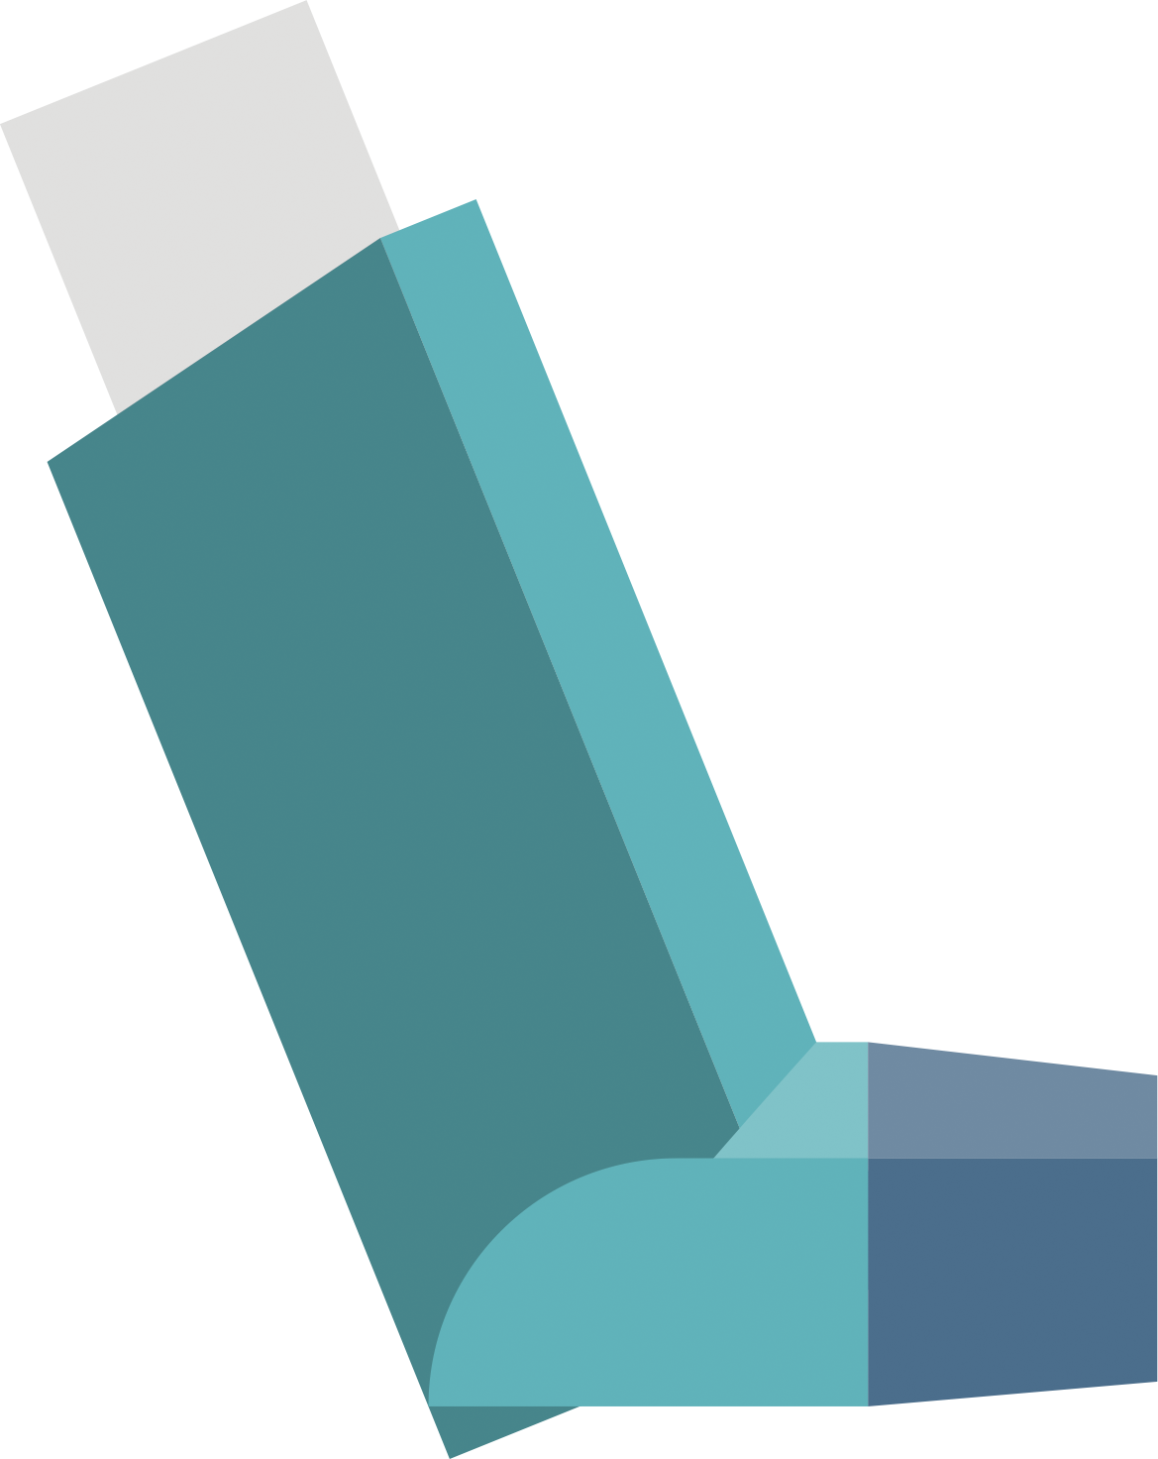
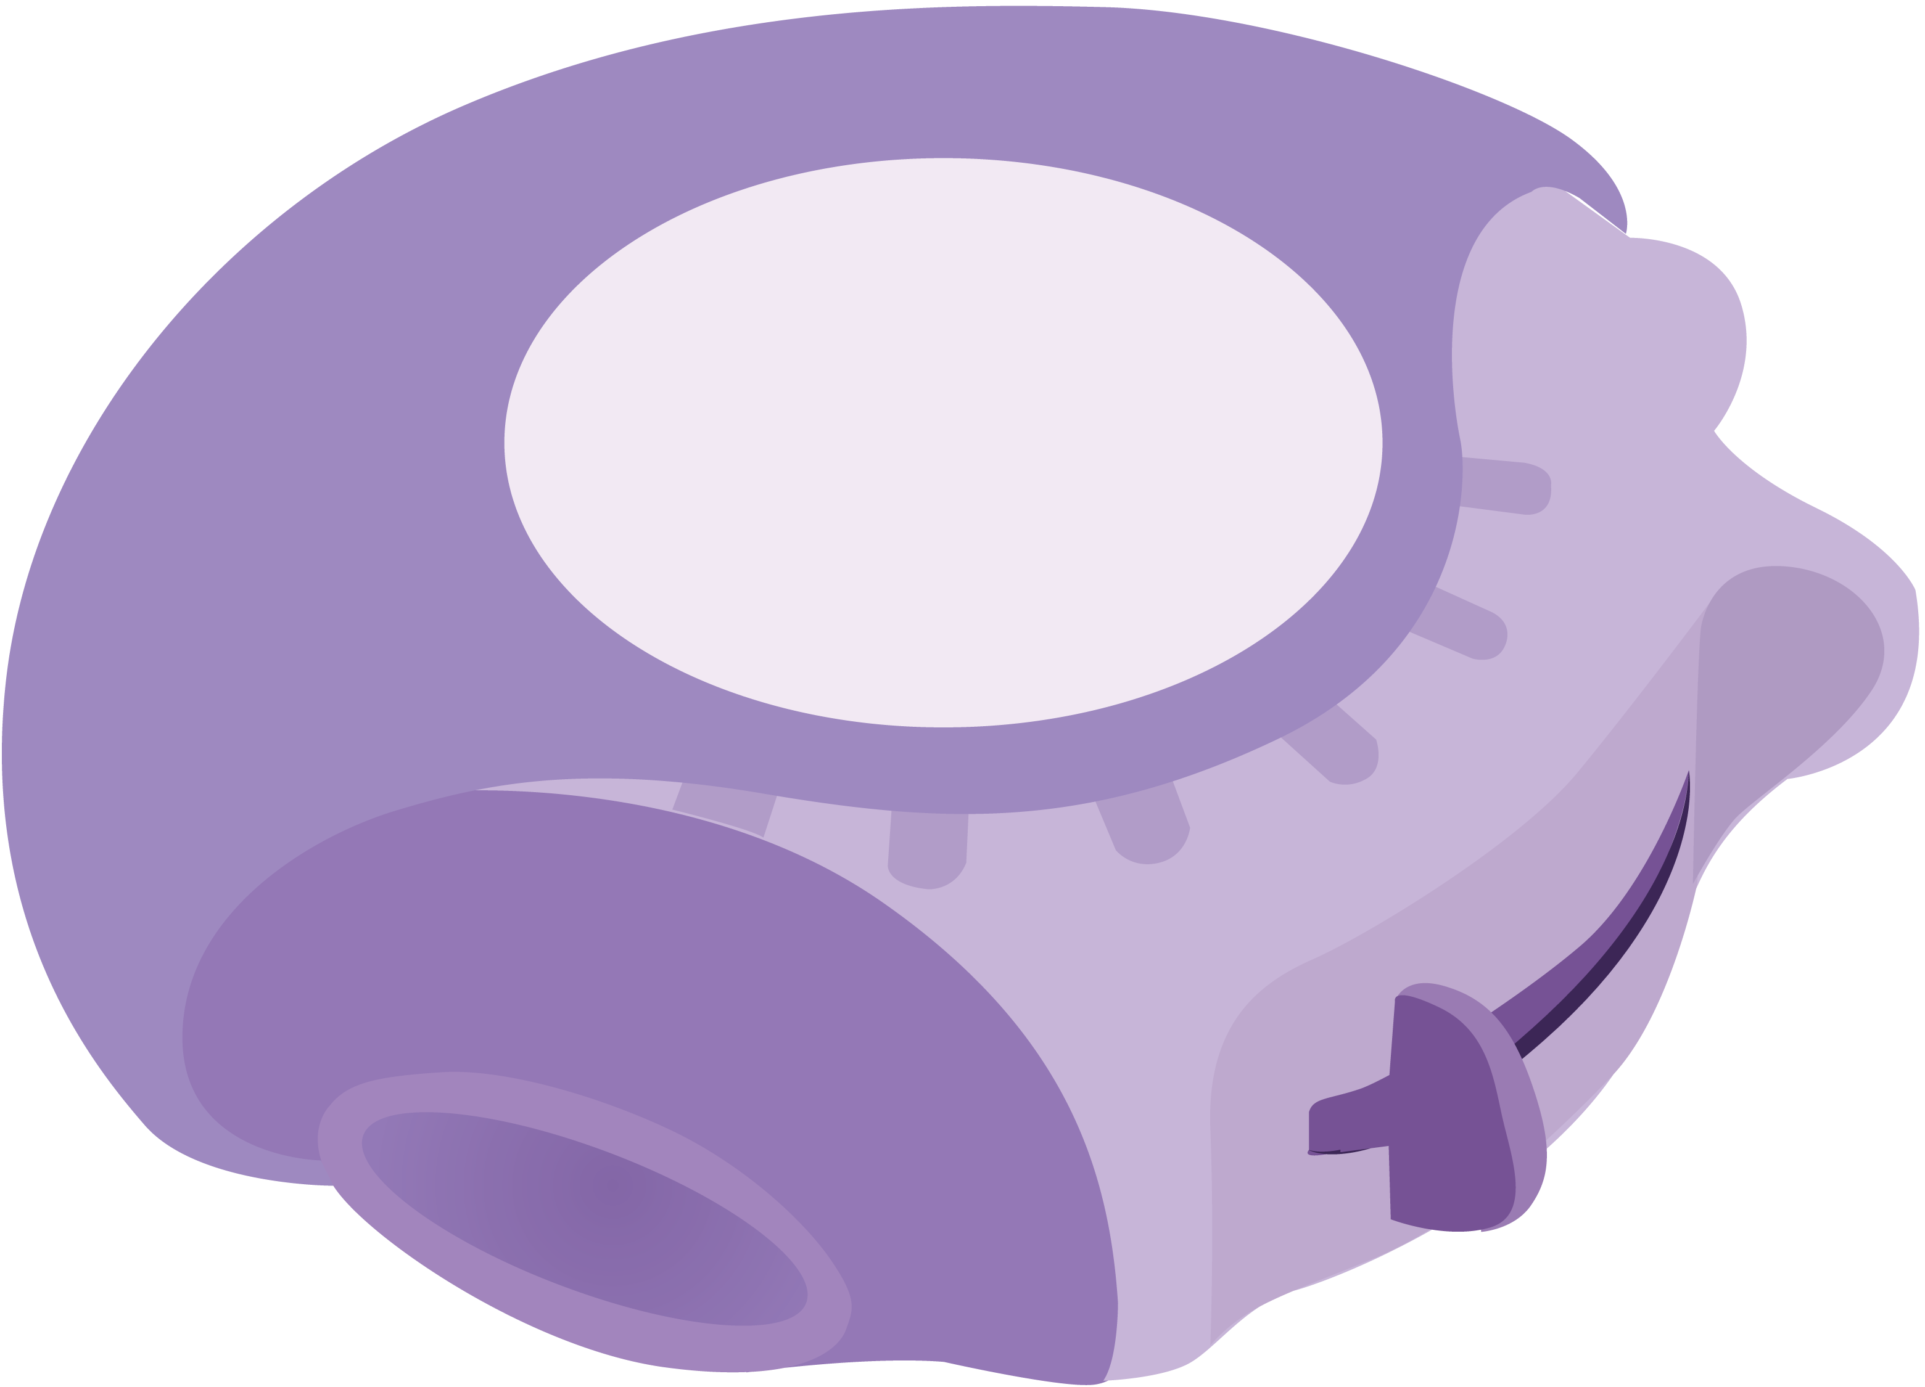
Different Types of OTC Pain Medications
A number of different types of medications are used to manage pain and related symptoms:
Over-the-counter (OTC) pain medications can be purchased at your local store or pharmacy
Prescription pain medications require a prescription from a healthcare professional and are only intended for the person with the prescription
BOTH come in a number of different forms including liquids, capsules, pills, drops, inhalers, injections, creams, sprays, patches, and more

Slide 6
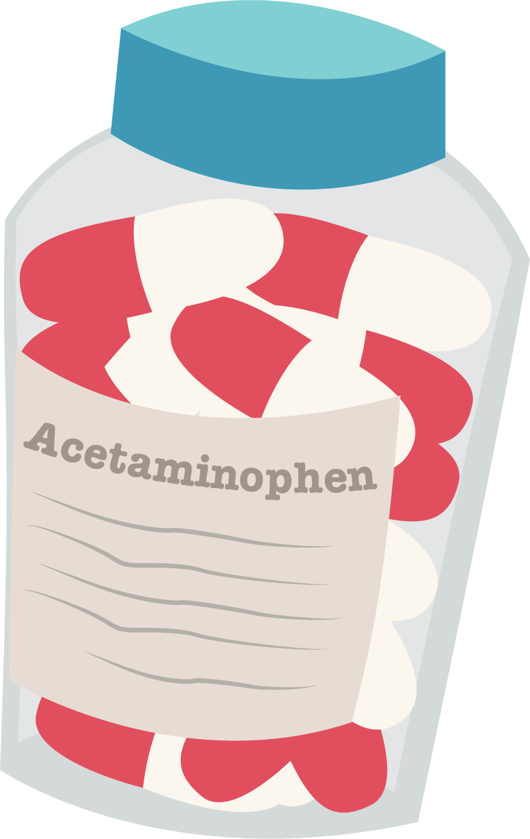
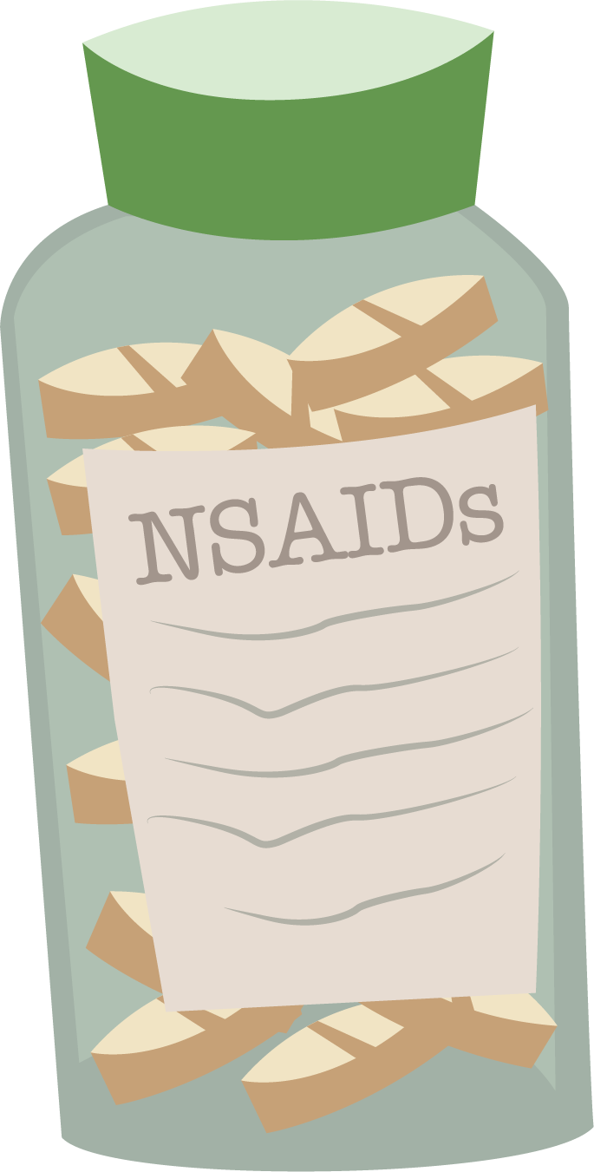
Two Main Types of OTC Pain Medications
Nearly 8 in 10 Americans reach for over-the-counter pain medications to help relieve temporary mild to moderate aches and pains, fevers, cold symptoms, and more
Those two main types of OTC pain medications are defined by their active ingredient—
Acetaminophen
Non-steroidal anti-inflammatory drugs (also known as NSAIDs)

Slide 8
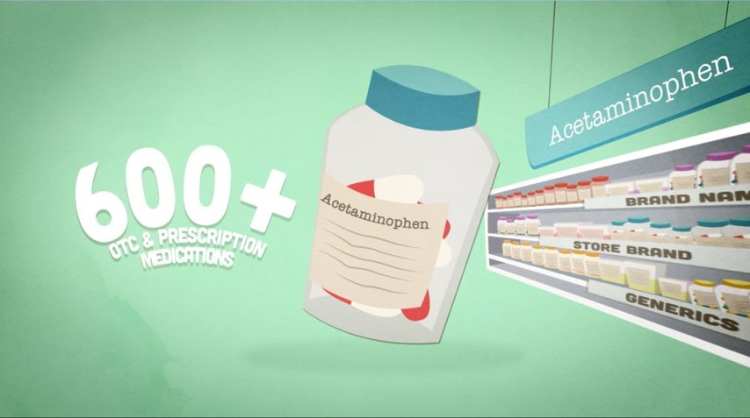
Acetaminophen
Acetaminophen is now found in more than 600 OTC and prescription medications

Slide 9
Common Medications that Contain Acetaminophen

Slide 10
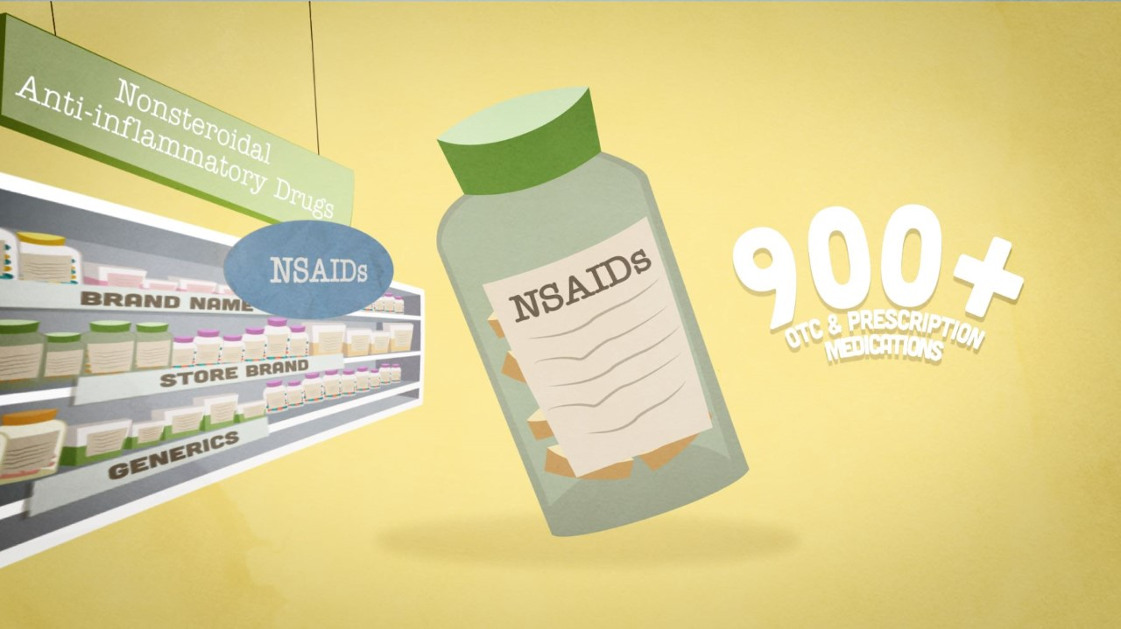
Non-Steroidal Anti-Inflammatory Drugs (NSAIDs)
NSAIDs are found in more than 900 OTC and prescription medications

Slide 11
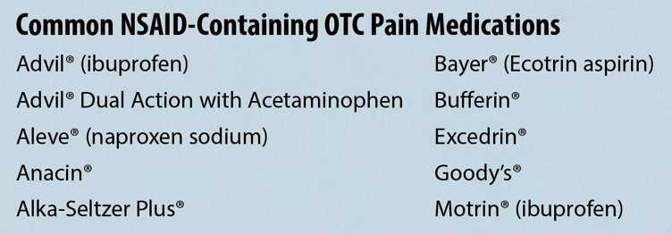
Common Medications that Contain NSAIDs

Slide 12
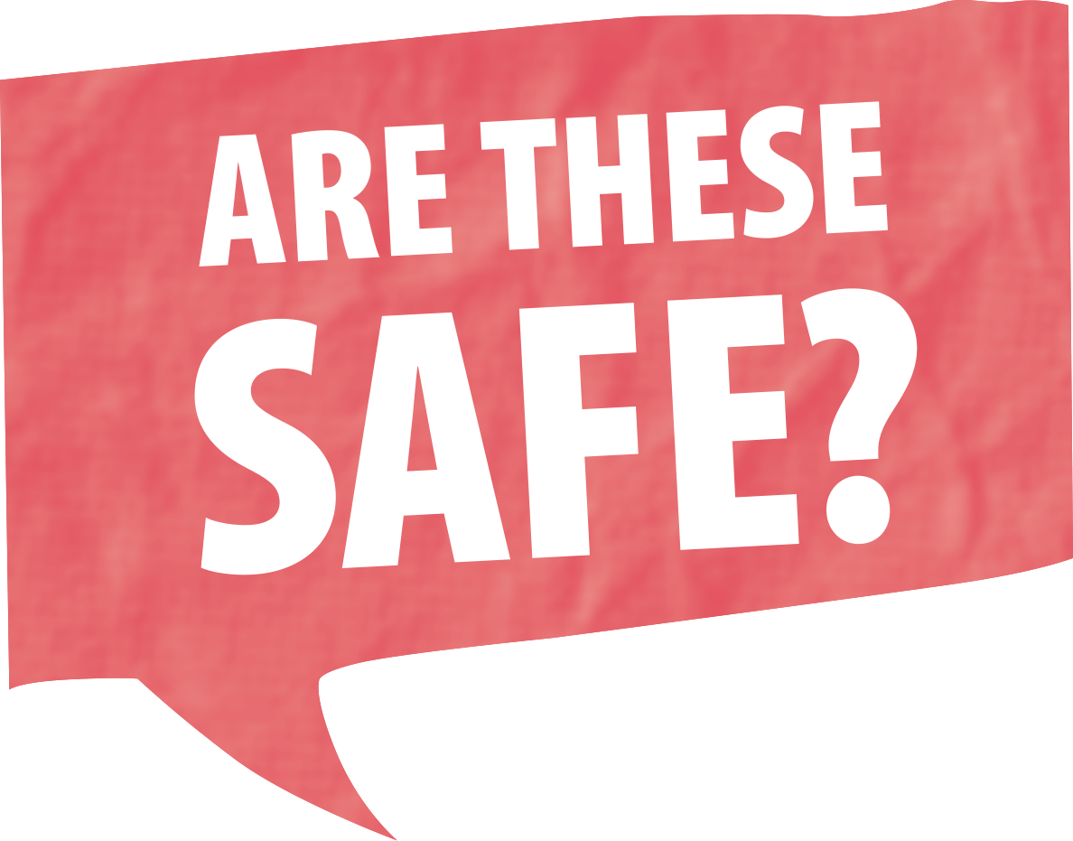
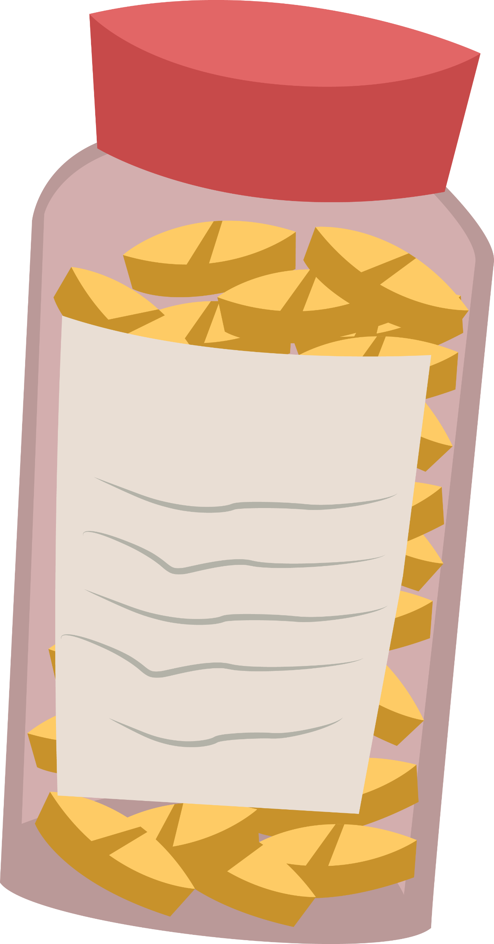
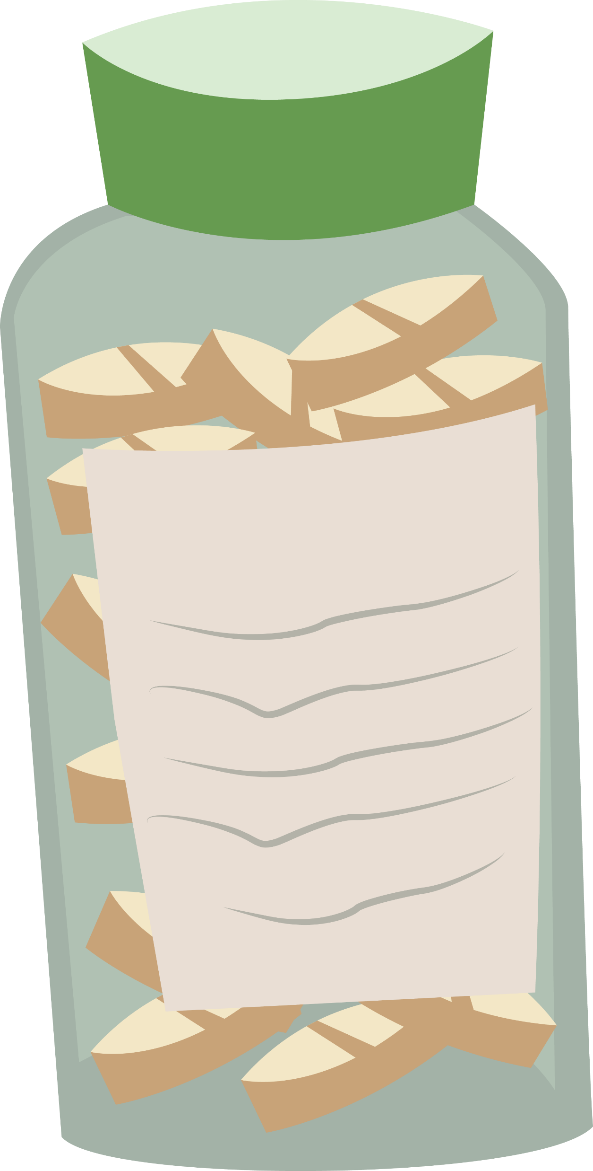
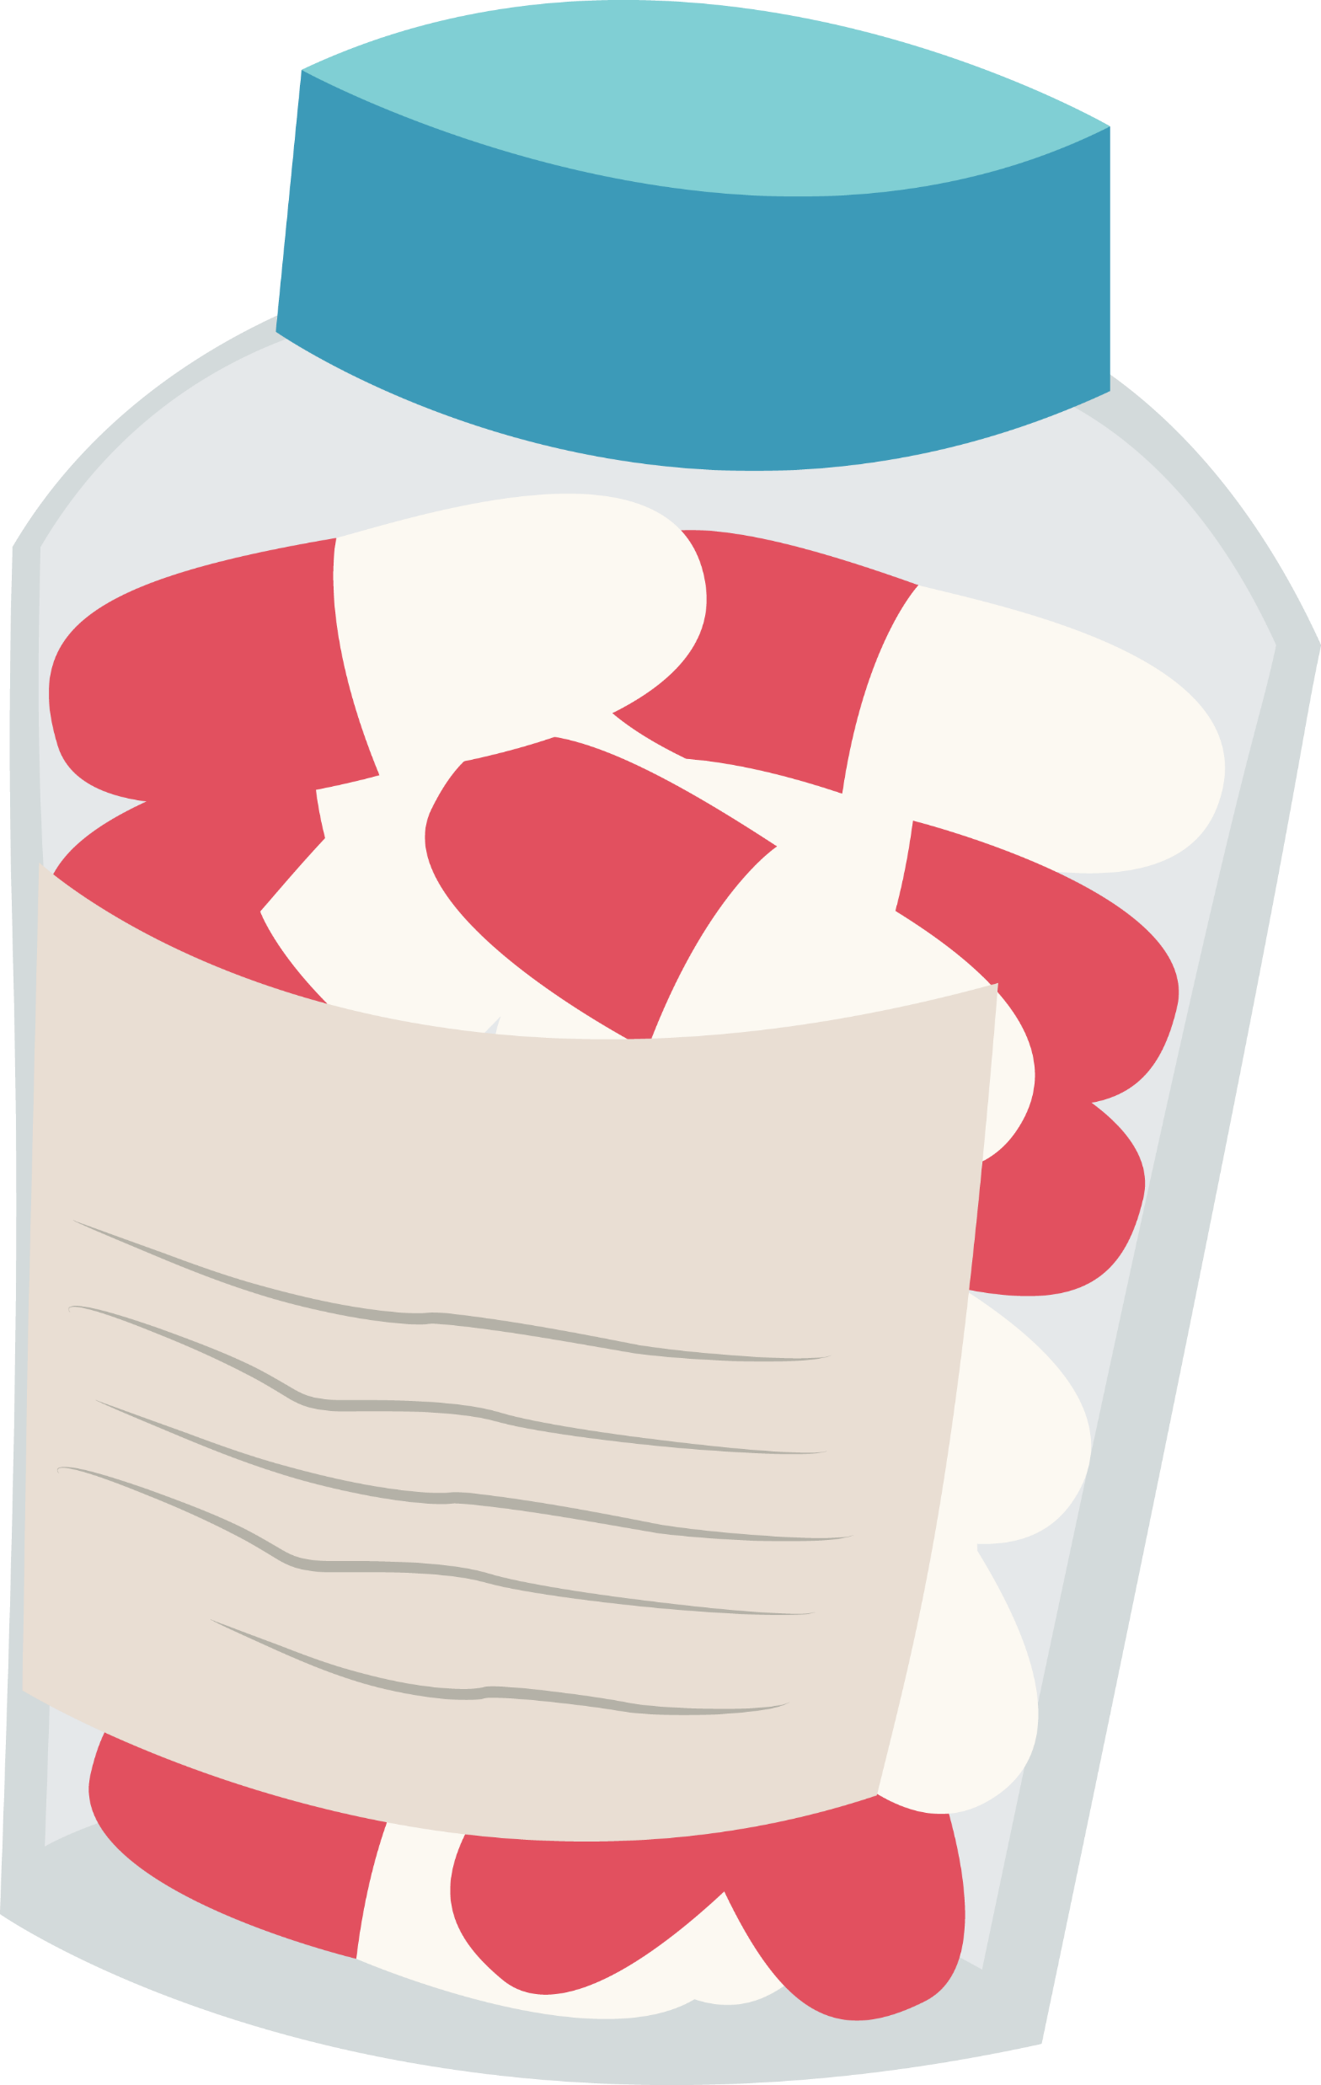
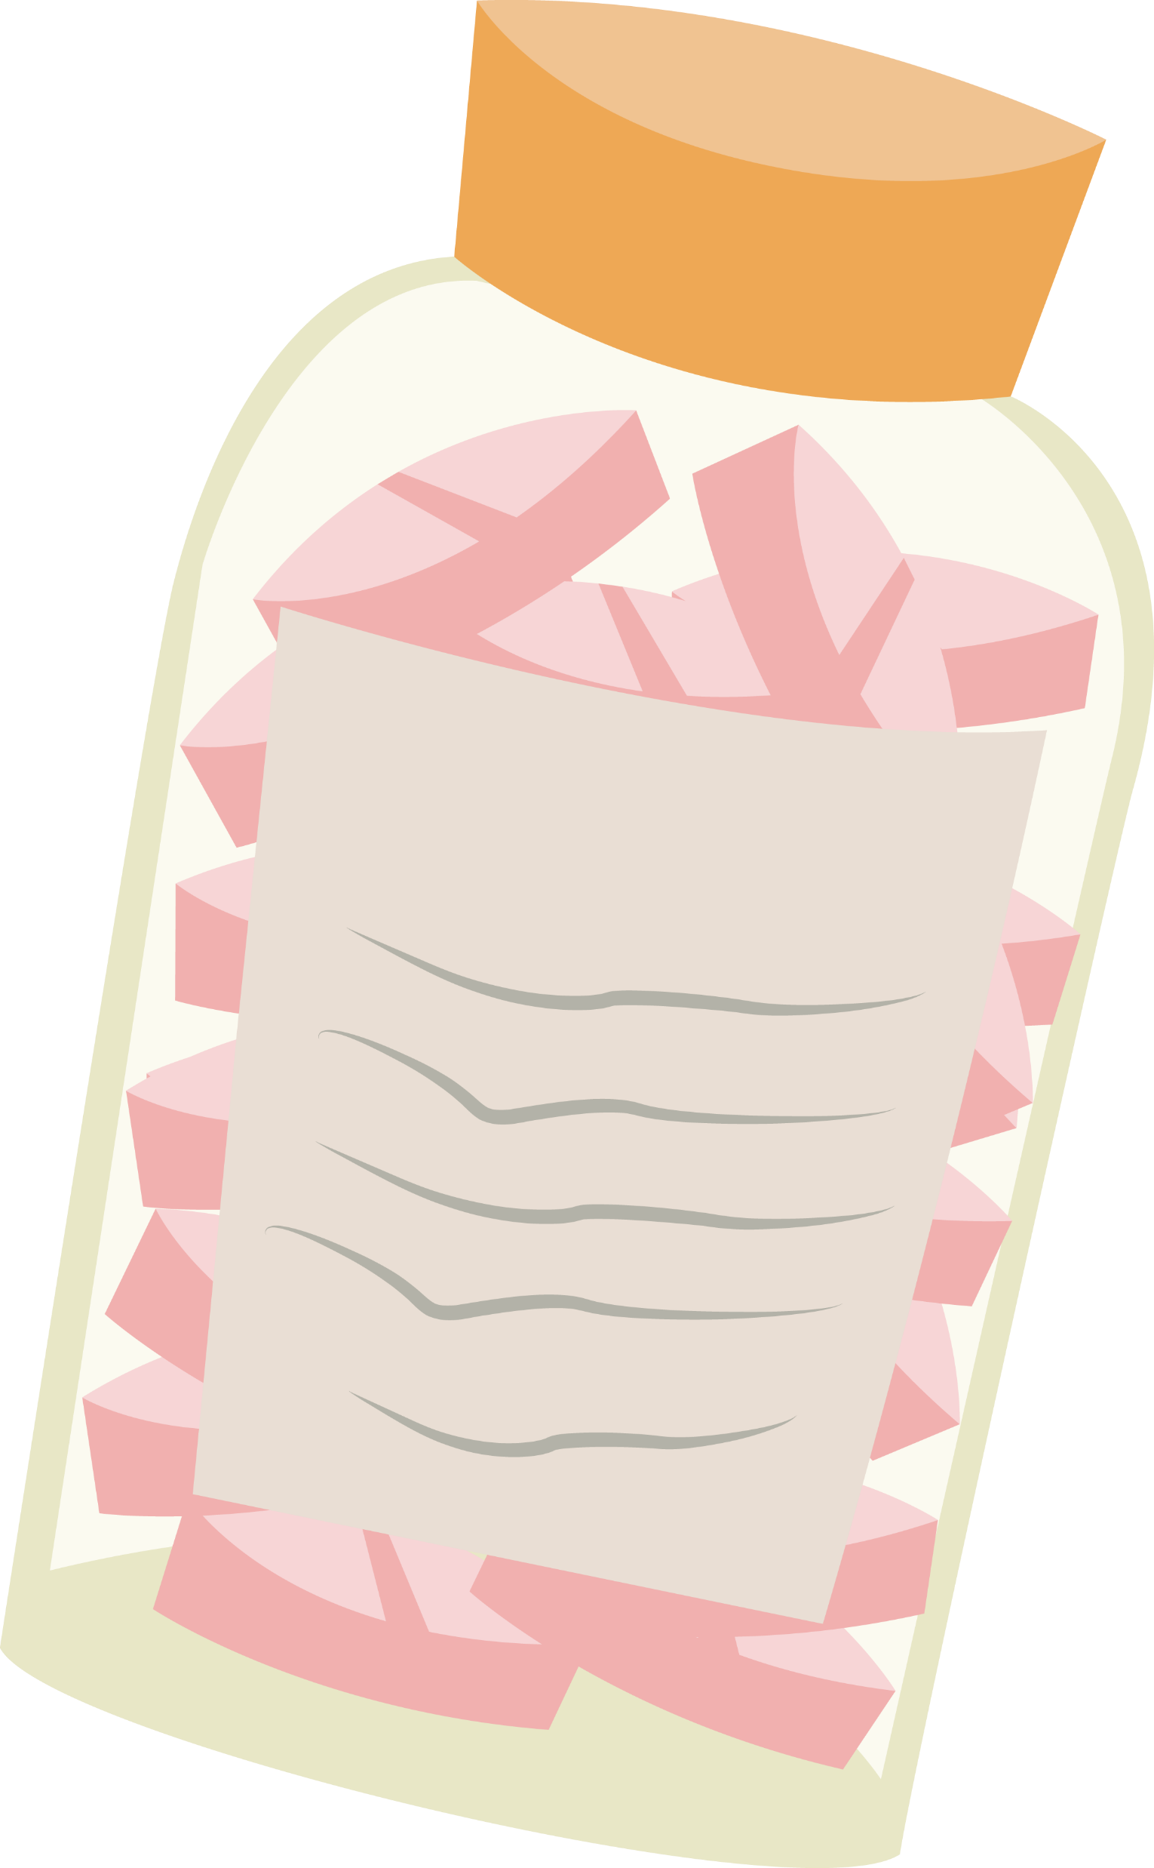
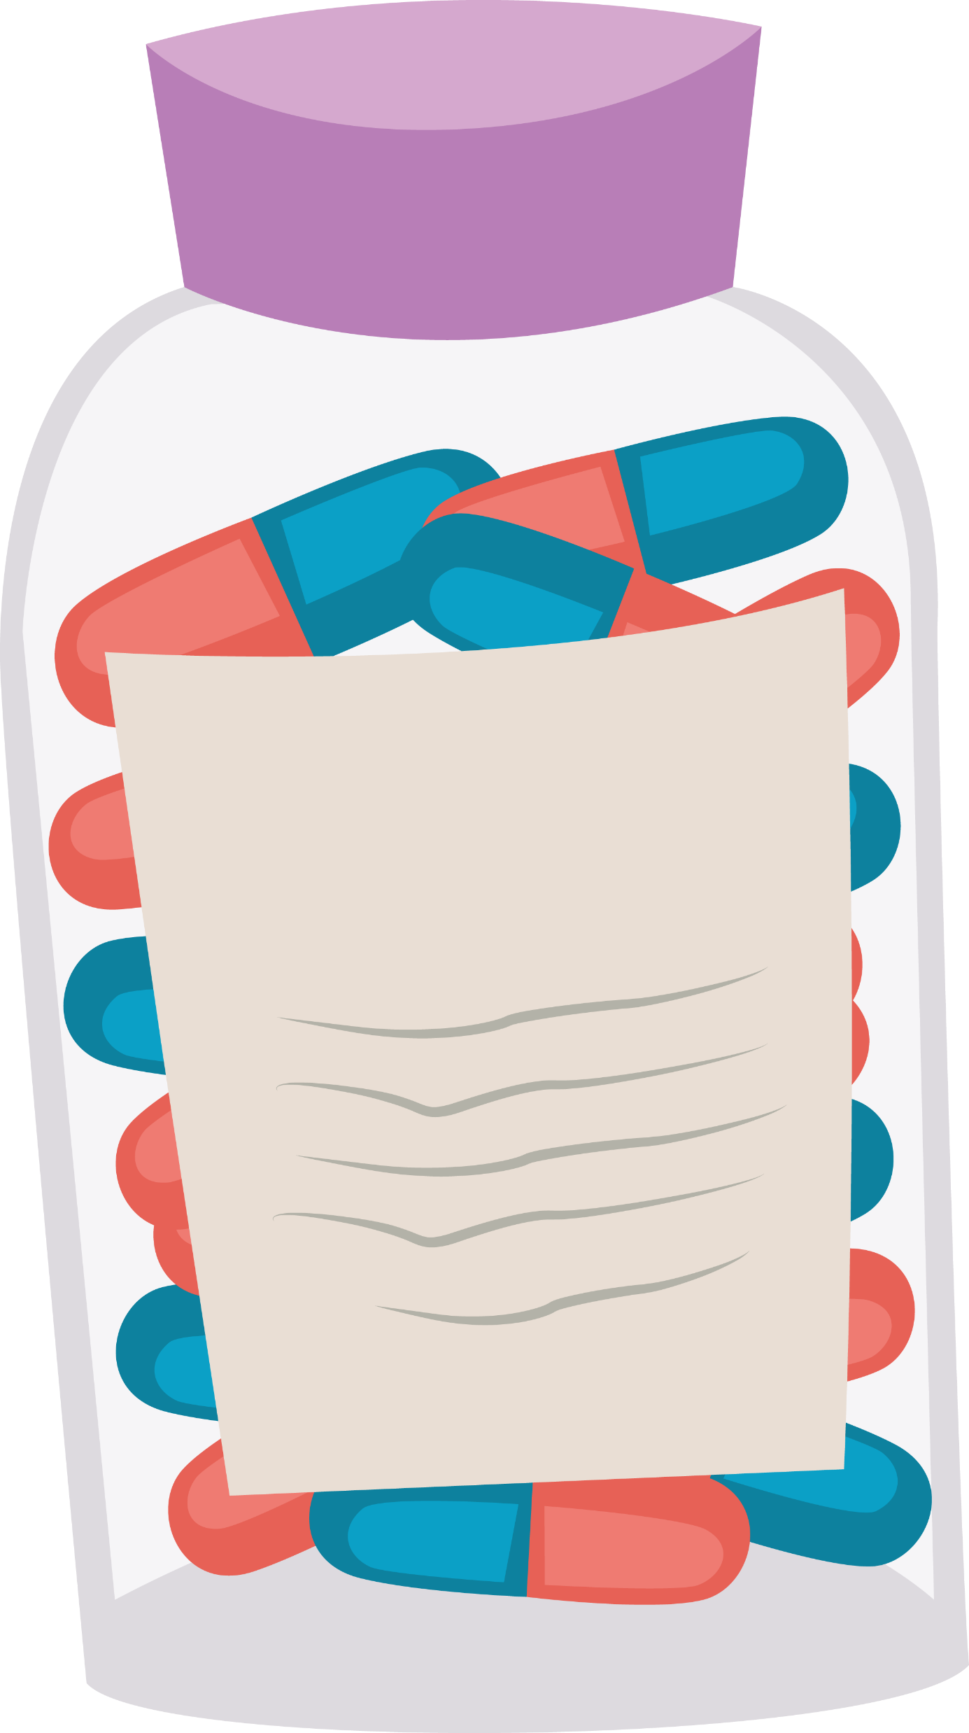
Safe & Effective When Taken as Directed
OTC pain medications are safe for most people when they take them as directed
However, although you can buy them without a prescription, all medications can be dangerous if misused or abused
One medication may be better for you than another because of other health conditions, medications, and age

Slide 13
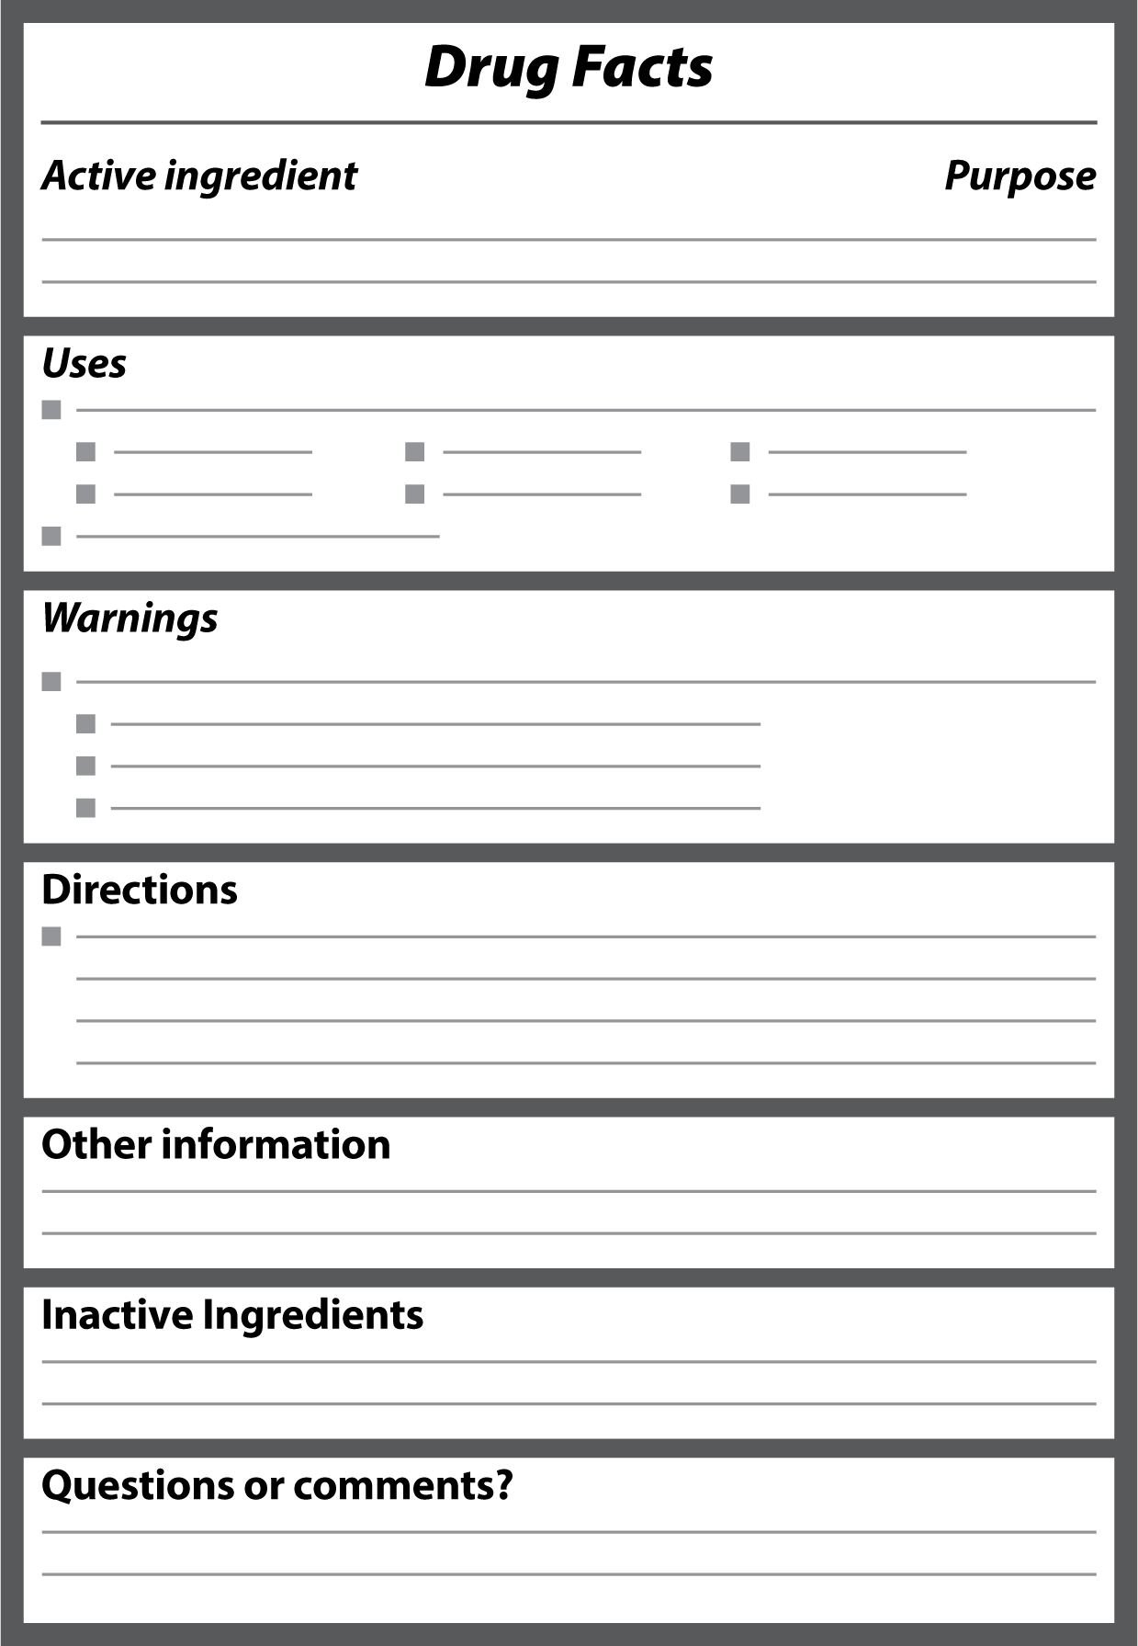
Understanding the Drug Facts Label

Slide 14
Understanding the Drug Facts Label Cont.
Acetaminophen
Ibuprofen (NSAID)
Notes:
Active Ingredients/Purpose

Slide 15
Understanding the Drug Facts Label Cont.
Acetaminophen
Ibuprofen (NSAID)
Notes:
Uses

Slide 16
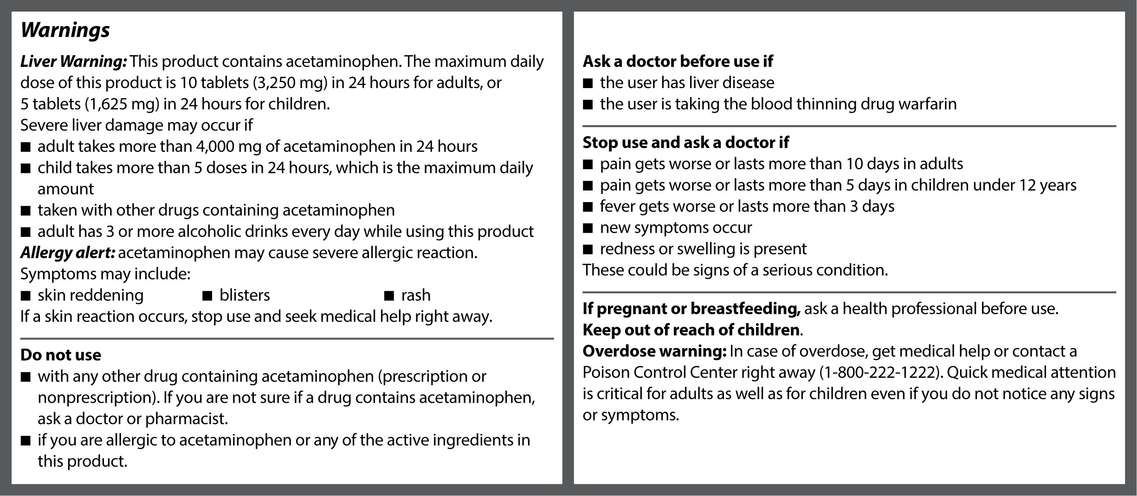
Understanding the Drug Facts Label Cont.
Acetaminophen
Notes:
Warnings: Acetaminophen

Slide 17
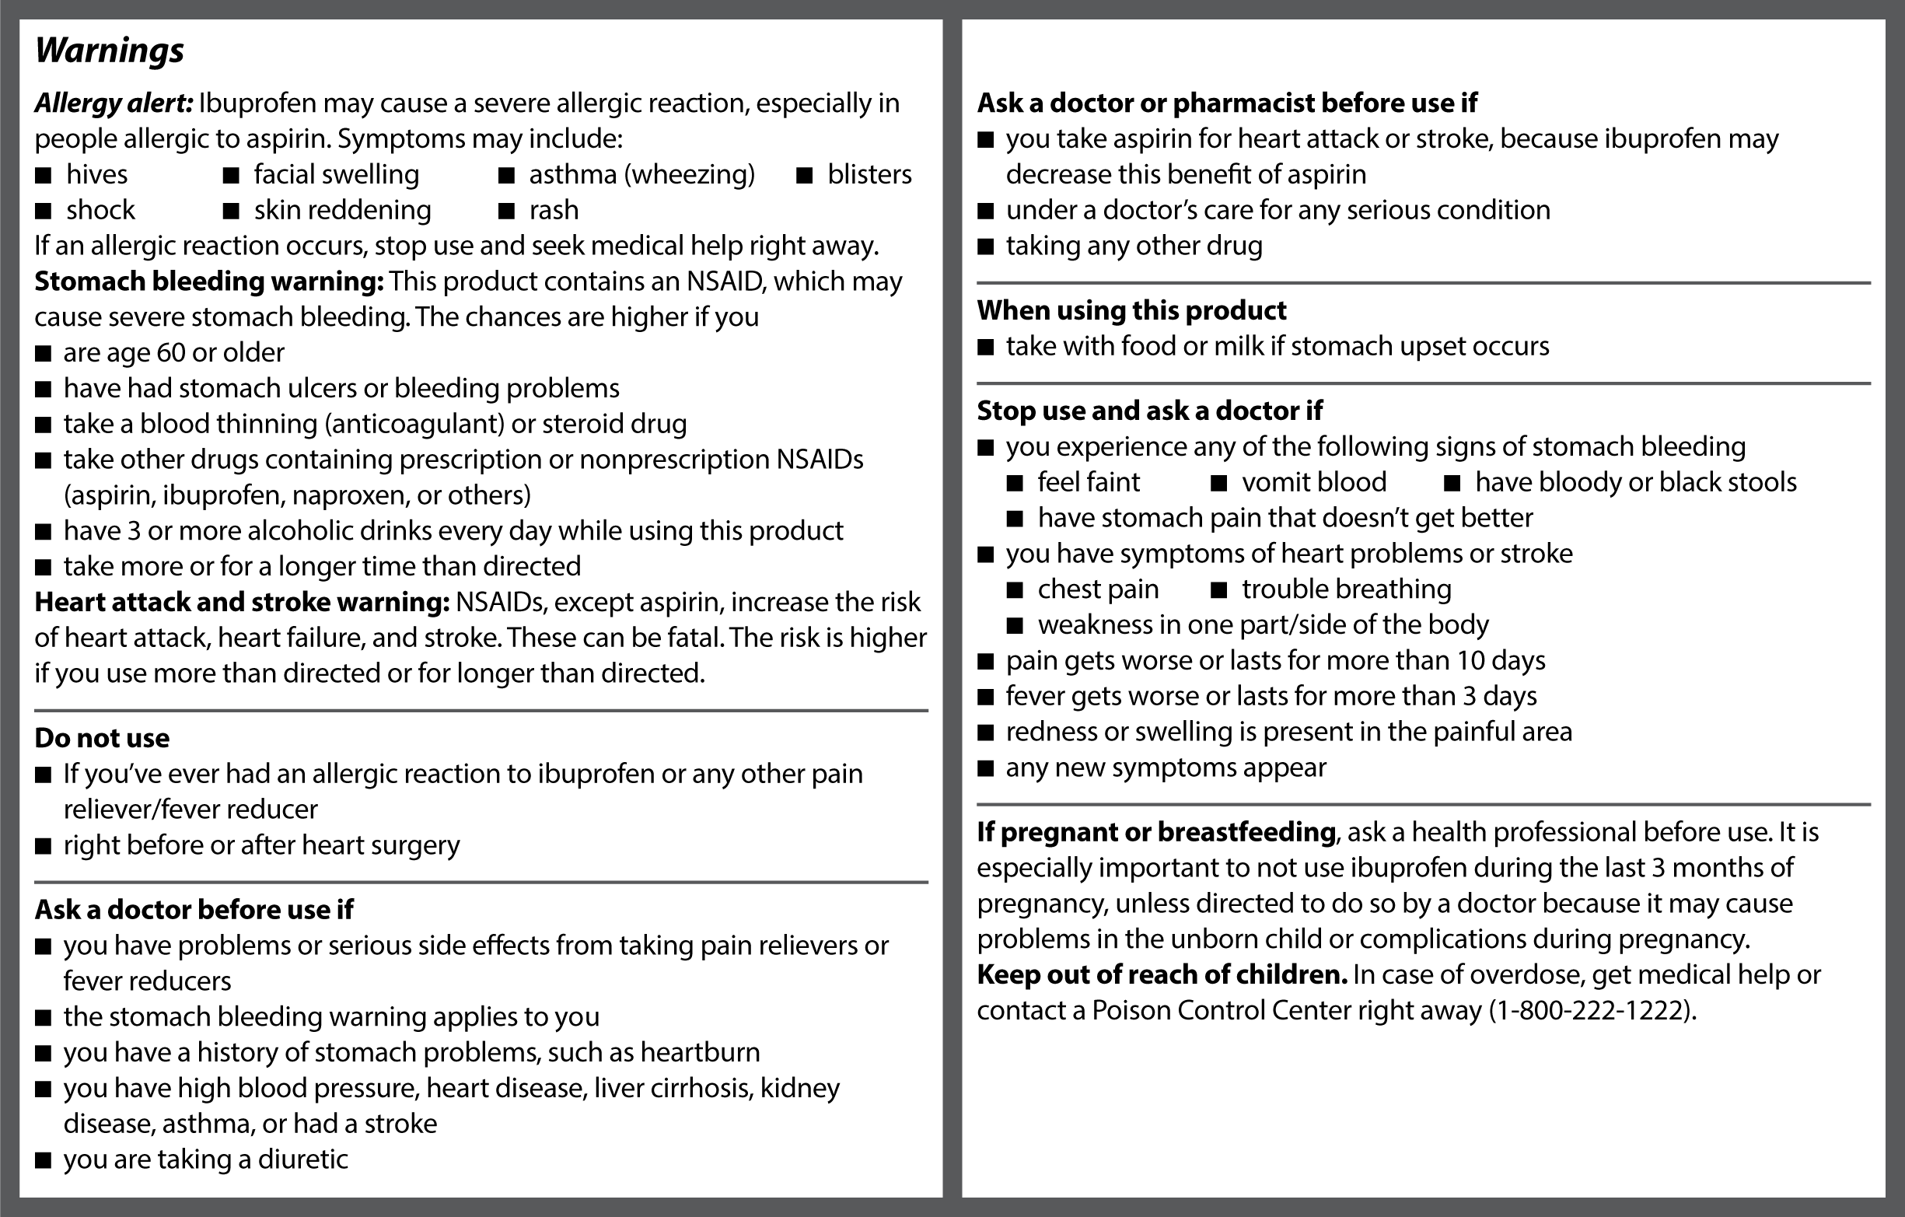
Understanding the Drug Facts Label Cont.
Ibuprofen (NSAID)
Notes:
Warnings: NSAID

Slide 18
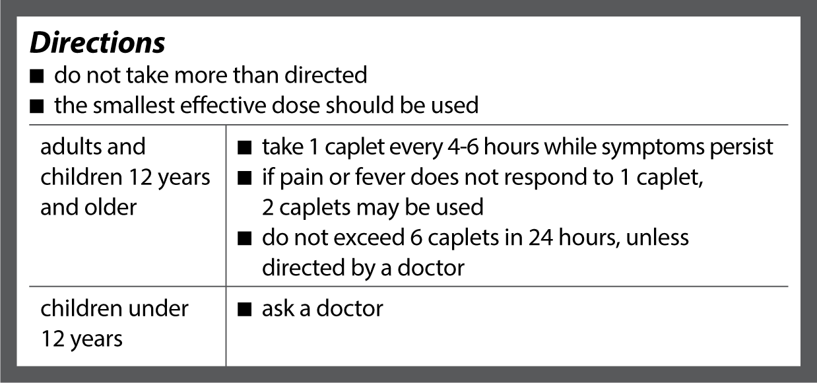
Understanding the Drug Facts Label Cont.
Acetaminophen
Ibuprofen (NSAID)
Notes:
Directions

Slide 19
Understanding the Drug Facts Label Cont.
Acetaminophen
Ibuprofen (NSAID)
Notes:
Other Information and Inactive Ingredients

Slide 20
Understanding the Drug Facts Label Cont.
Acetaminophen and Ibuprofen (NSAID)
Notes:
Questions or Comments

Slide 21
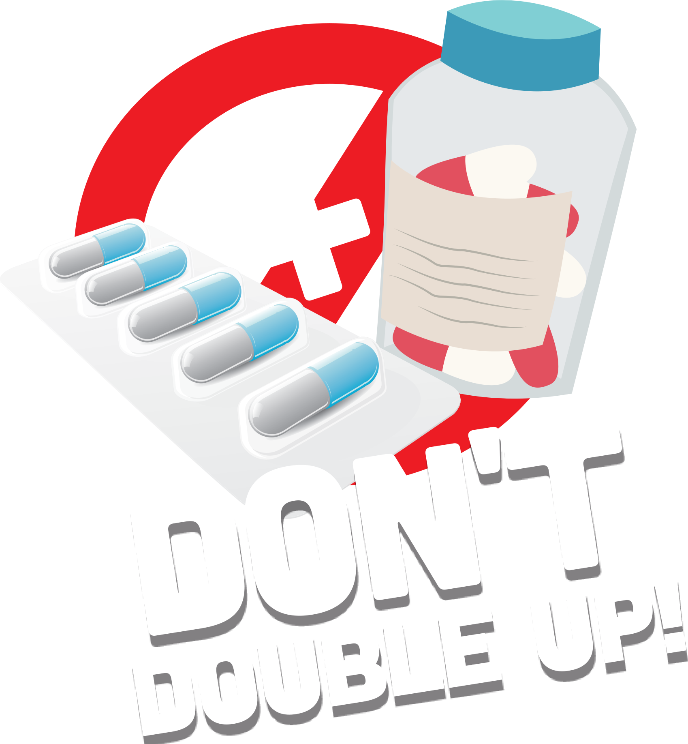
Taking OTC Medications Safely
DO read the directions every time – even if you’ve used the medication before
DO take the smallest effective dose for the shortest period of time needed
DO talk to your healthcare professional (HCP) if the medication doesn’t relieve your pain
DO stop use and ask a HCP if pain gets worse or lasts more than 10 days
DO stop use and ask a HCP if fever gets worse or lasts more than 3 days
DON’T take more than directed in one dose or in a 24-hour period
DON’T take another dose too soon
DON’T use kitchen spoons or household utensils to measure your medications
DON’T double up by taking more than one medication with the same active ingredient at the same time

Slide 22
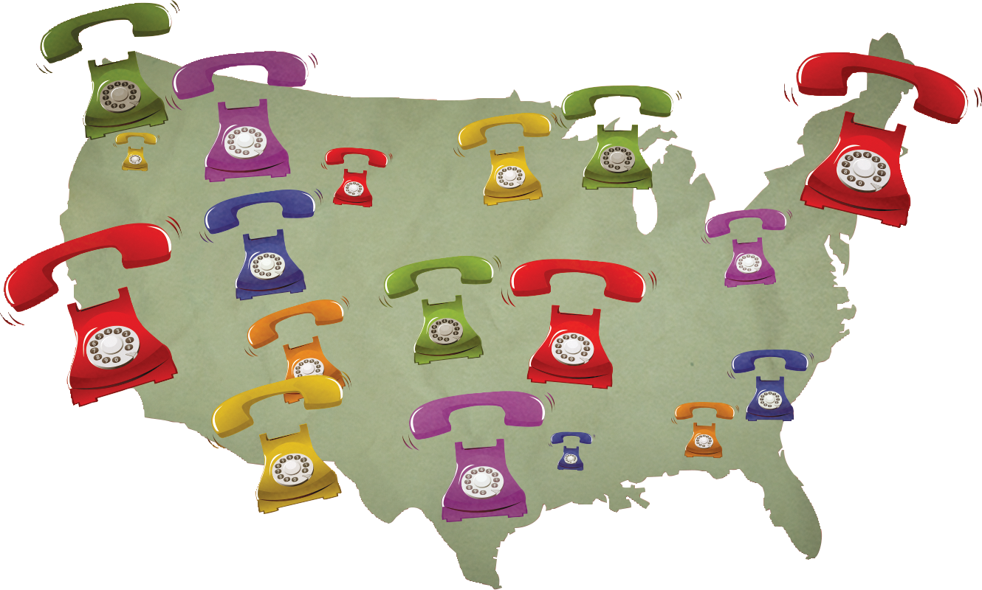
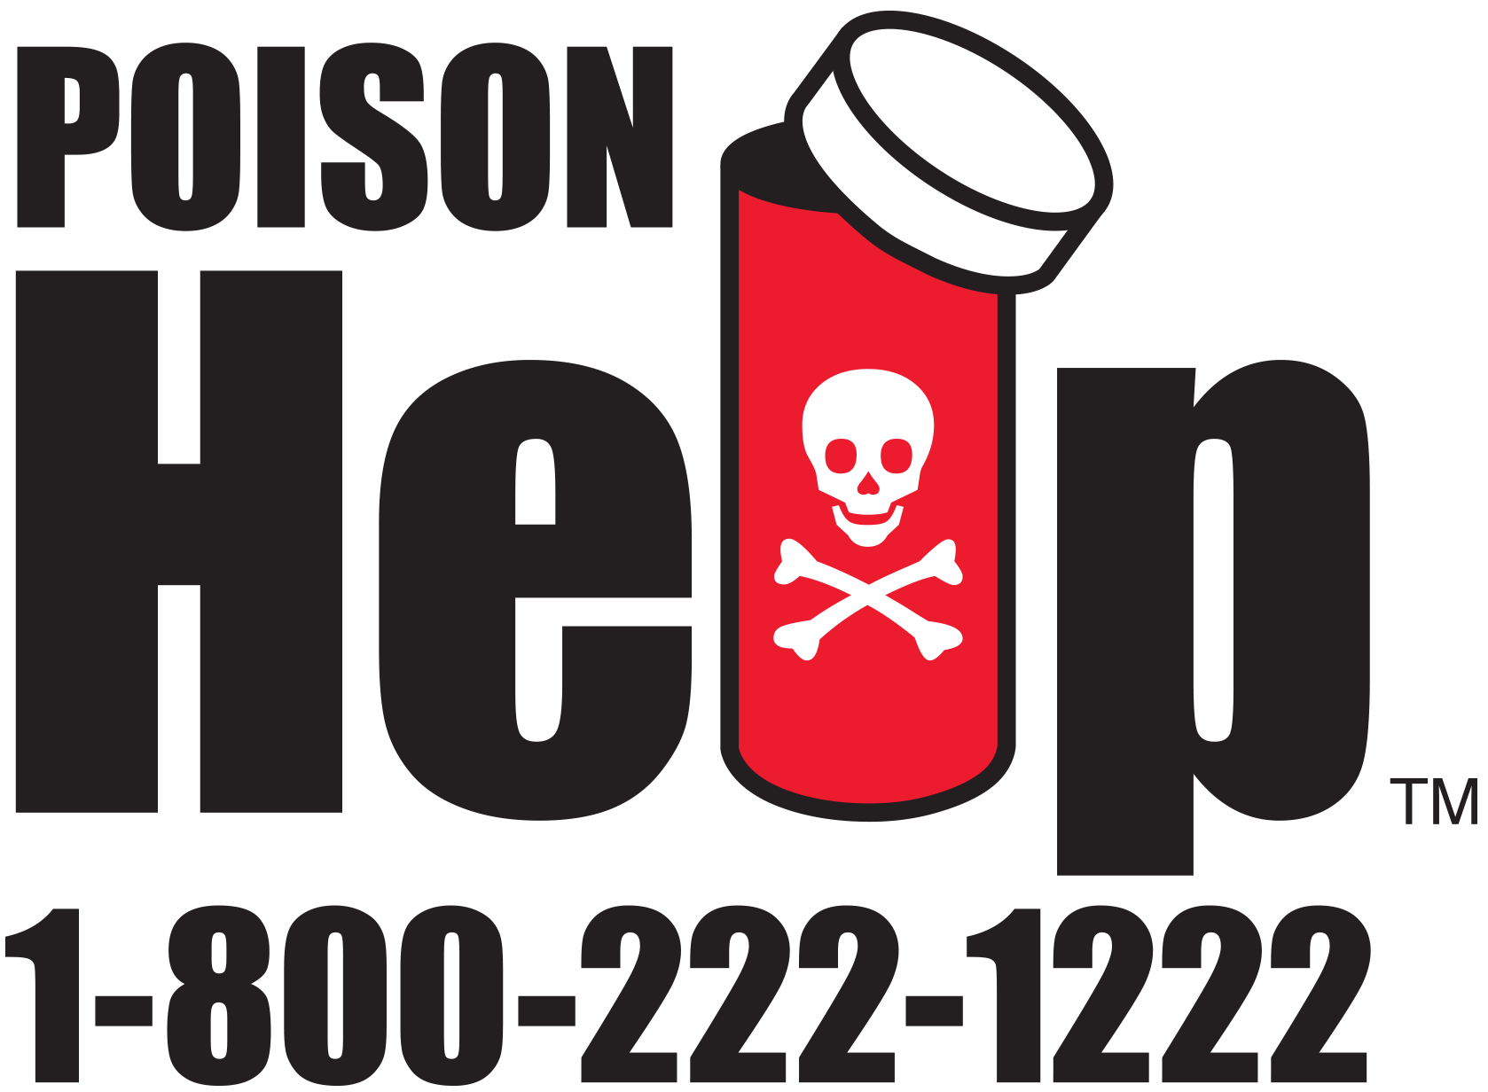
In Case of an Overdose
Taking more than directed is an overdose, and severe consequences can occur
Call Poison Control if you or someone you know takes more than the recommended dose

Slide 23
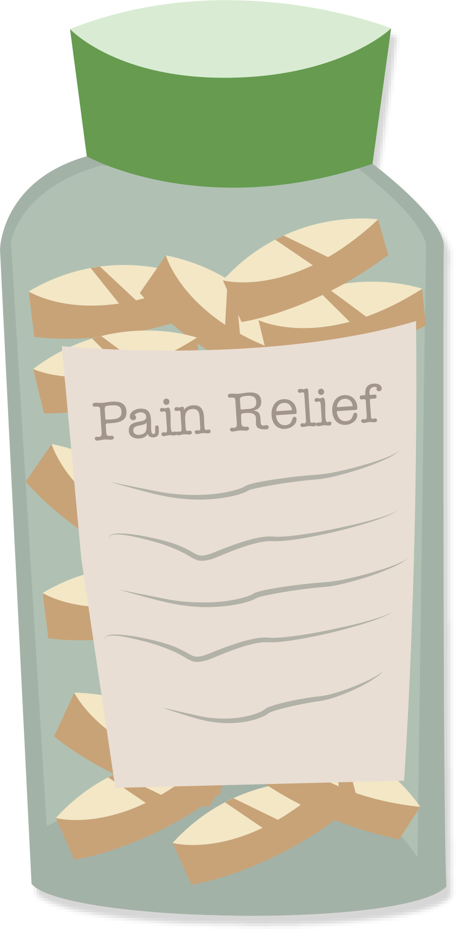
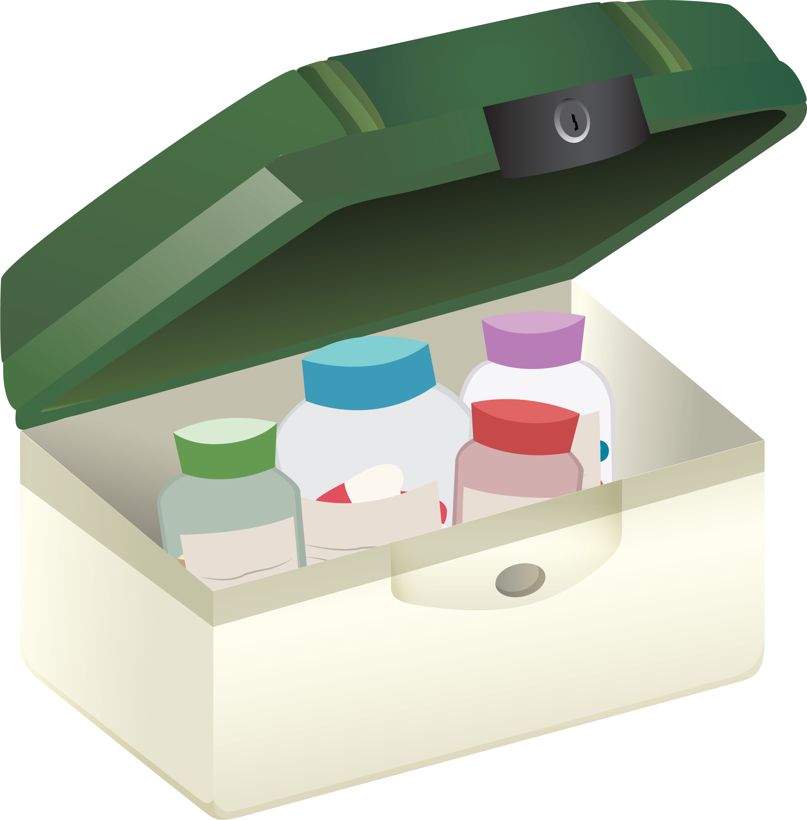
Preventing Abuse of Prescription Medications
Prescription misuse and abuse often starts in the home so be sure you:
Never share your prescription medications
Always keep medications stored safely and in their original containers to avoid any confusion and relock all safety caps
Always store prescription pain medications up and away and out of sight of family members or visitors in your home—especially young children
Only use as prescribed
Make sure you understand and follow dosing directions
Never take more than one medication with the same active ingredient at the same time unless directed to by your healthcare professional
Seek advice from your healthcare professional to determine whether or not you are ready to stop using your prescription medication

Slide 24
Non-Drug Therapies for Pain Management
There are a number of non-drug therapies that can be used as alternatives or alongside your pain medications. Be sure to discuss with your healthcare professional before you start any of these.
Non-drug therapy options include but are not limited to:
• Mind-body exercises like yoga and meditation
• Aromatherapy
• Deep breathing
• Pet therapy
• Acupuncture or massage
• Regular exercise routines
• Physical therapy
• Pain management devices

Slide 26
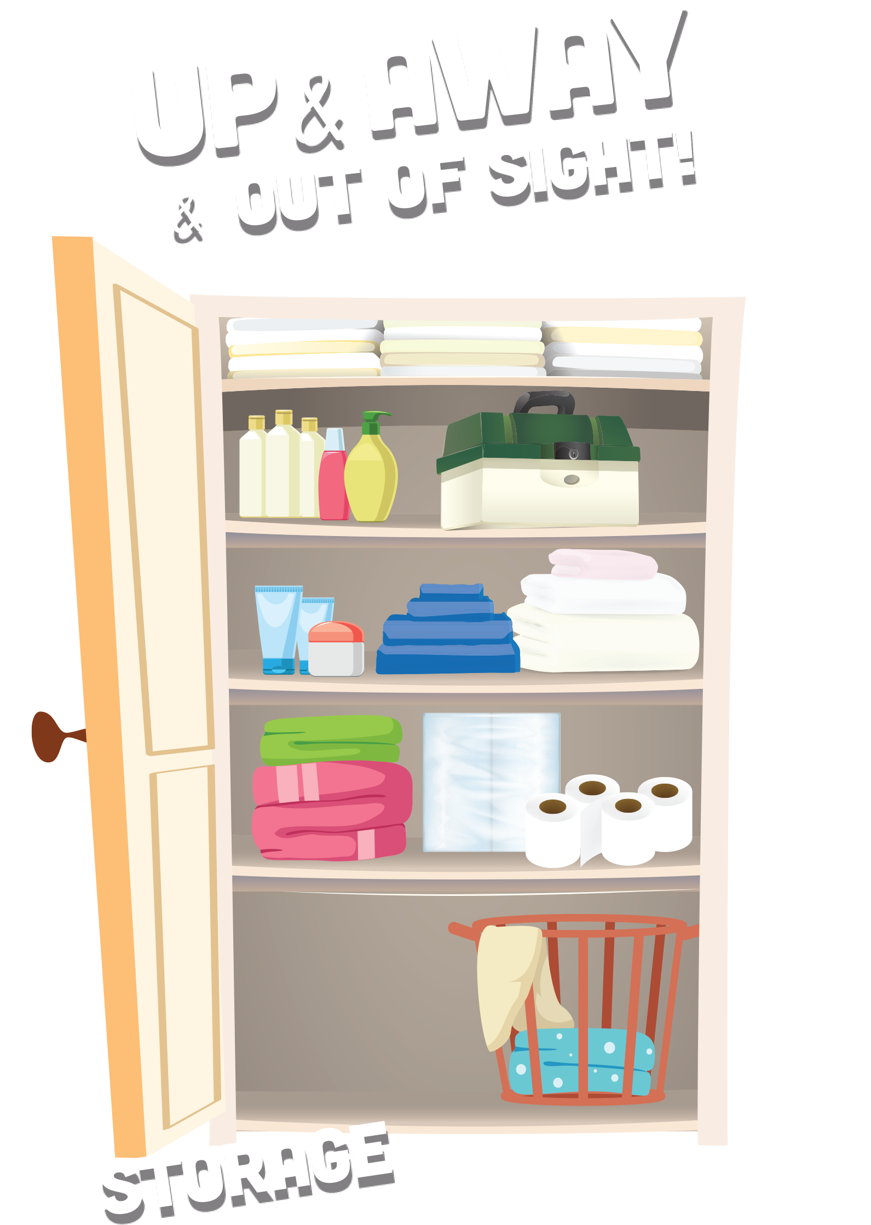
Storing Your Medications
Keep your medications in their original container or packaging
If you can, avoid mixing multiple medications in the same container
Store your medications somewhere cool and dry

Slide 27
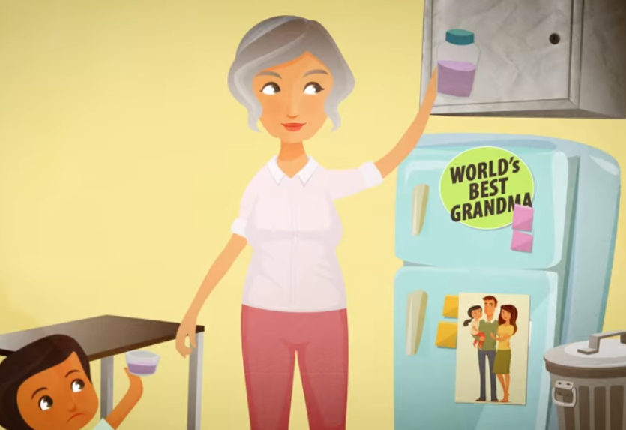
Up and Away and Out of Sight
Store medications up and away and out of sight—maybe on the top shelf of a cabinet or hall closet
Never leave medications out on a table, countertop, or sink, or any spot that is easy for children to access
Consider storing medications in a lockable storage container
Keep purses, bags, and coats that contain medications up and away, and out of reach at home and when visiting others
Relock safety caps tightly

Slide 29
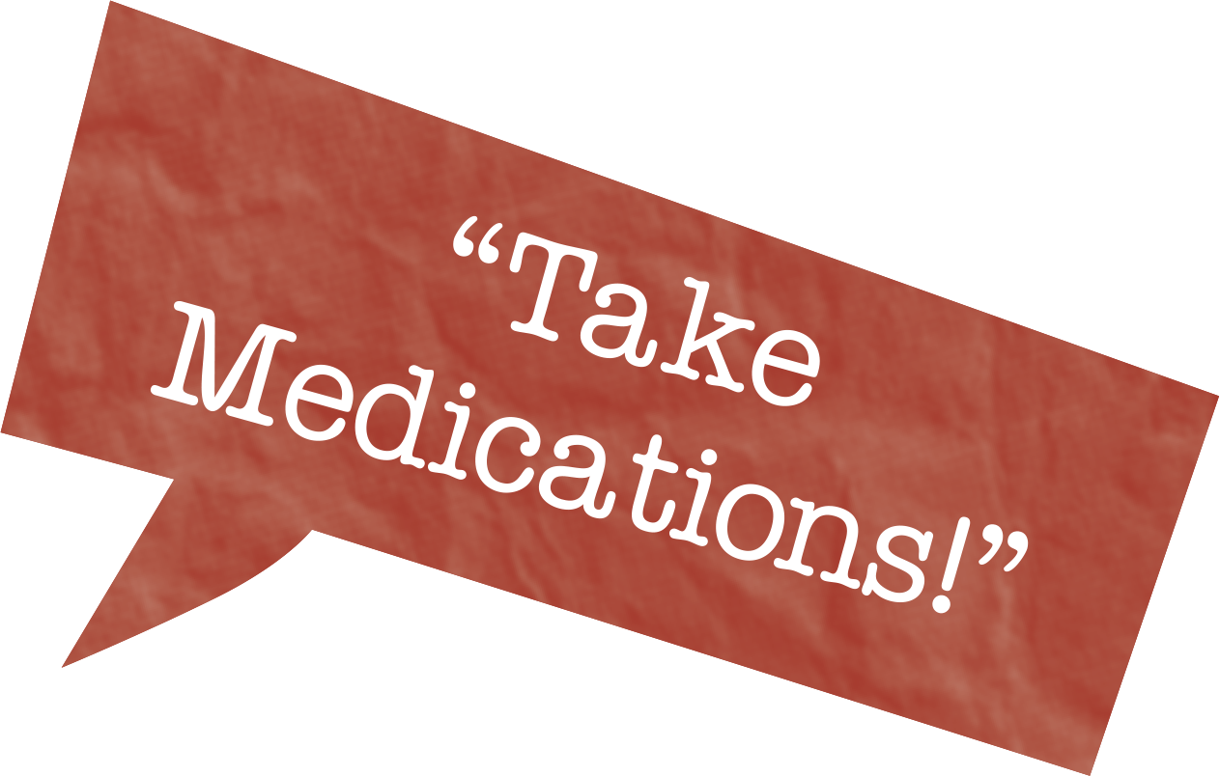
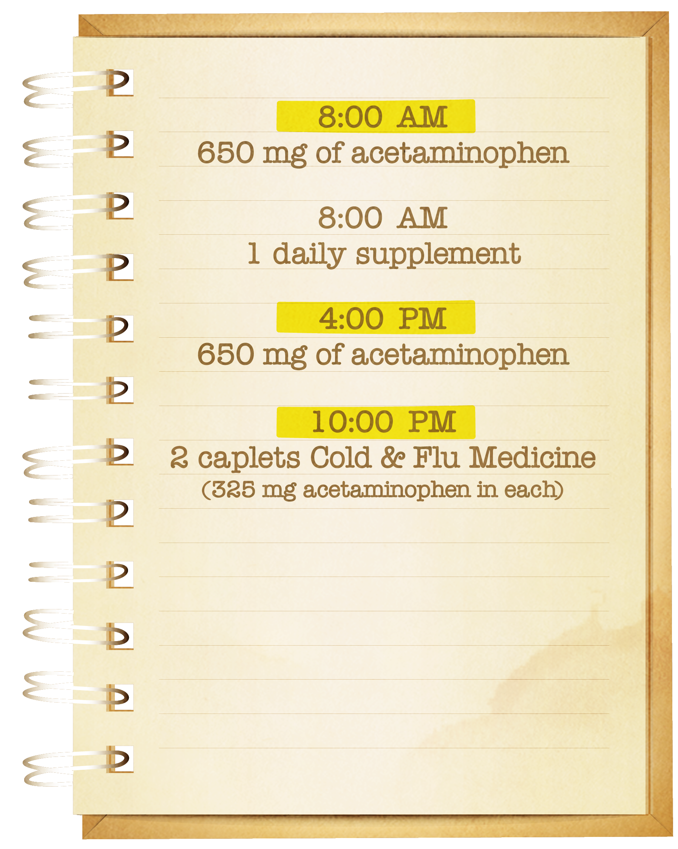
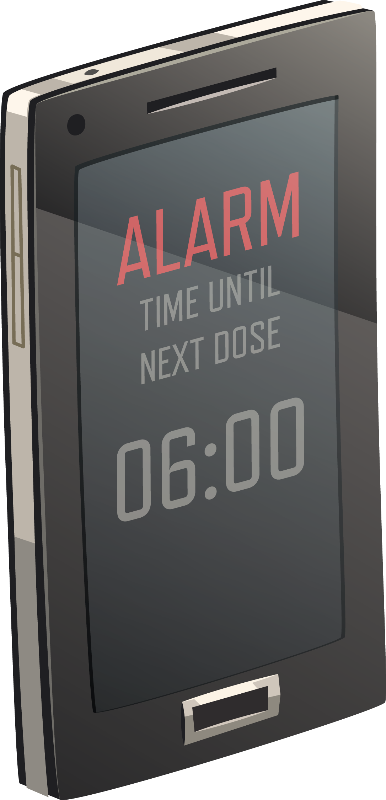
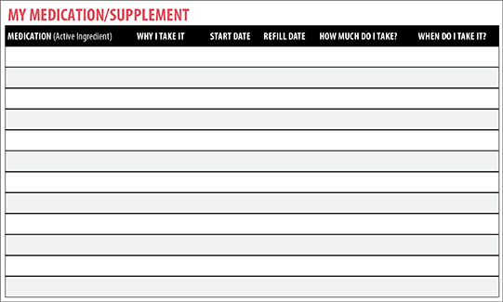
Keeping Track of Your Medications

Slide 30
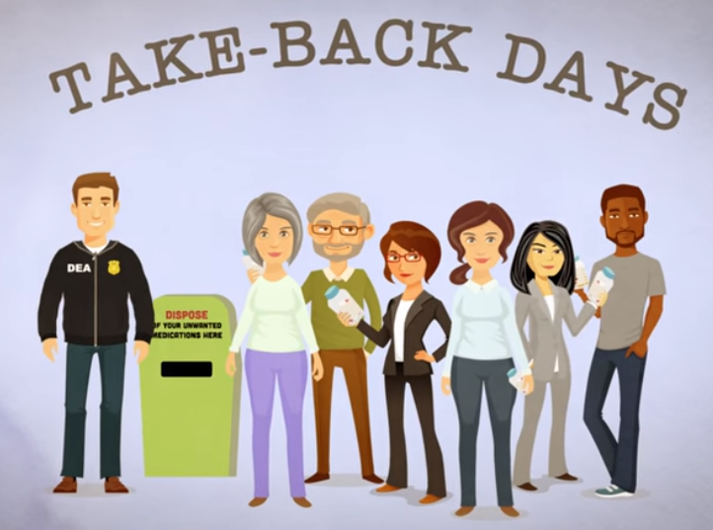
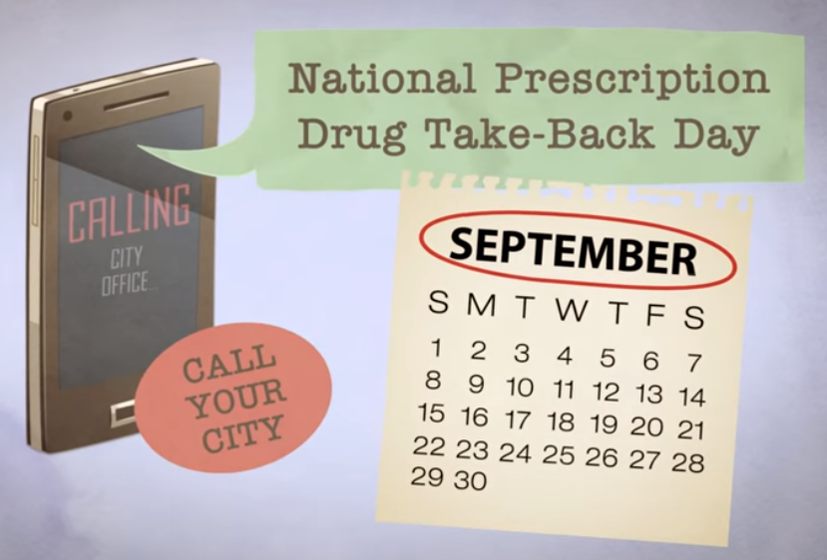
Disposing of Medications

Slide 31
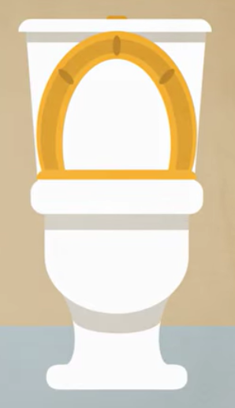
FDA’s Flush List for Certain Medications
If you can’t get to a drug take back site to dispose of your medications, check to see if your medication is on the Flush List
The Flush List includes medications that:
1) Are sought-after for their misuse and/or abuse potential
2) Can result in death from one dose if taken inappropriately
Flushing medicines on the Flush List helps keep everyone at home safe
Don’t flush your medication unless it is on the Flush List

Slide 32
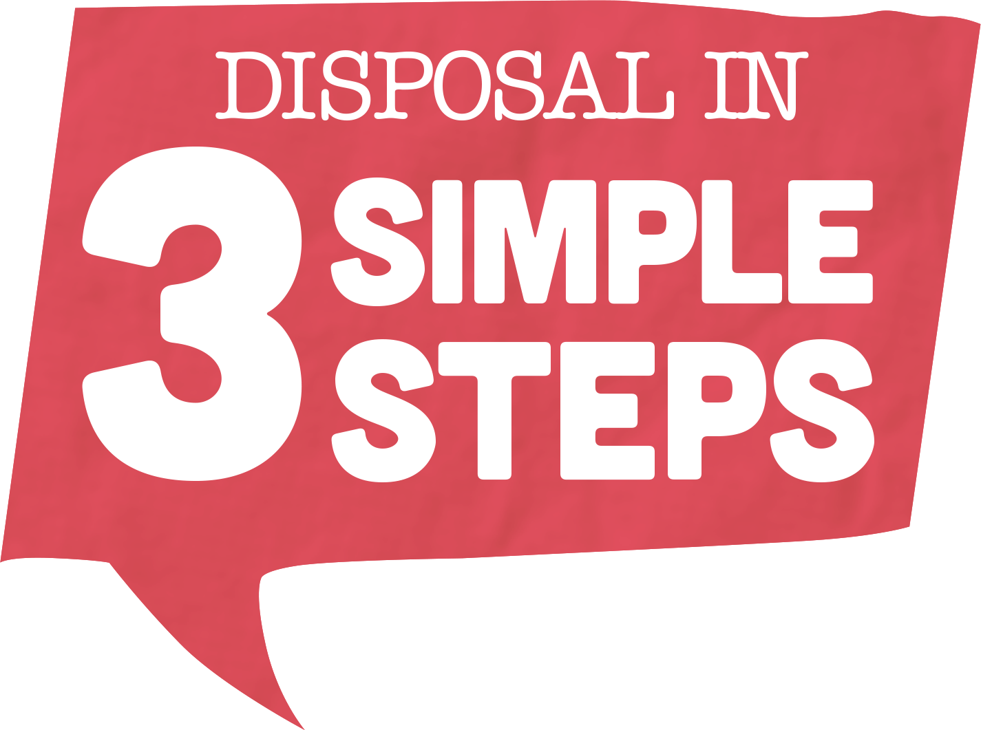
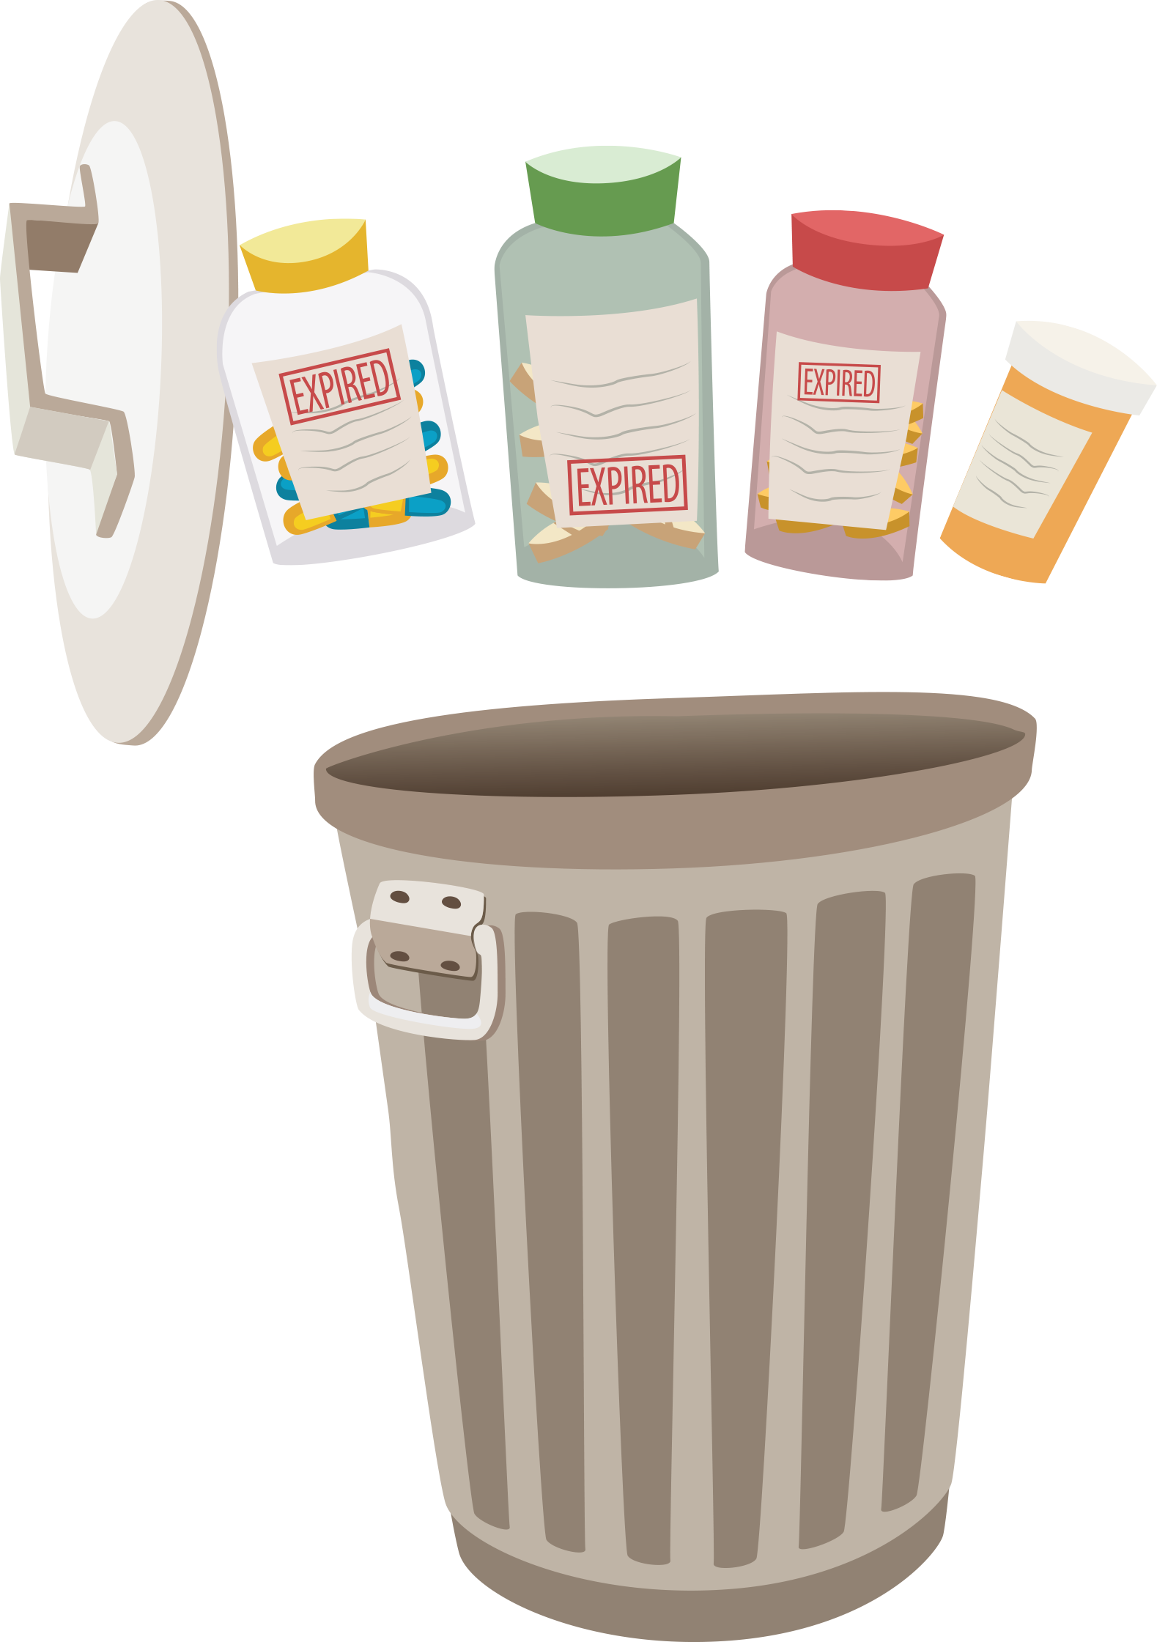
Throw Away Medications in 3 Easy Steps

Slide 33
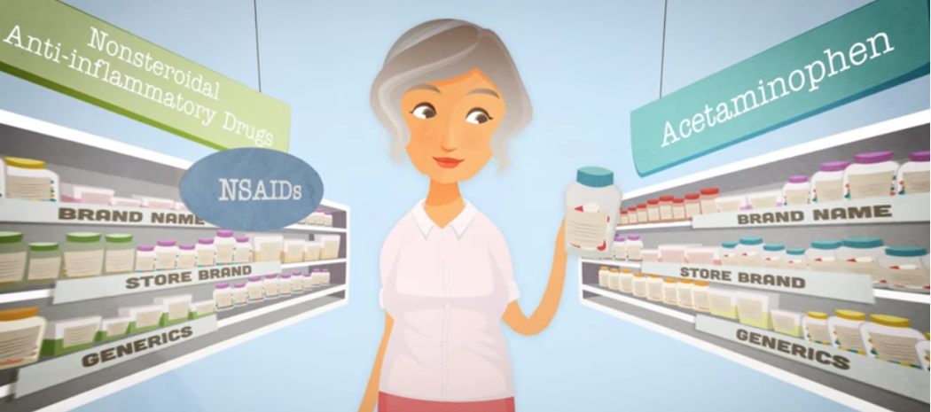
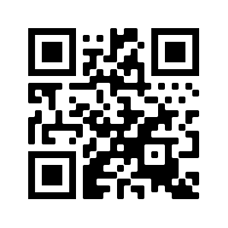
What Have We Learned?
Please take a few minutes to take the post-survey that will help the workshop creators understand how effective the resources are.
bit.ly/painworkshop2
Remember that your answers are anonymous!

Slide 34
For questions or comments, contact: The Alliance for Aging Research 202-293-2856 info@agingresearch.org
With Support From:

