Slide 1
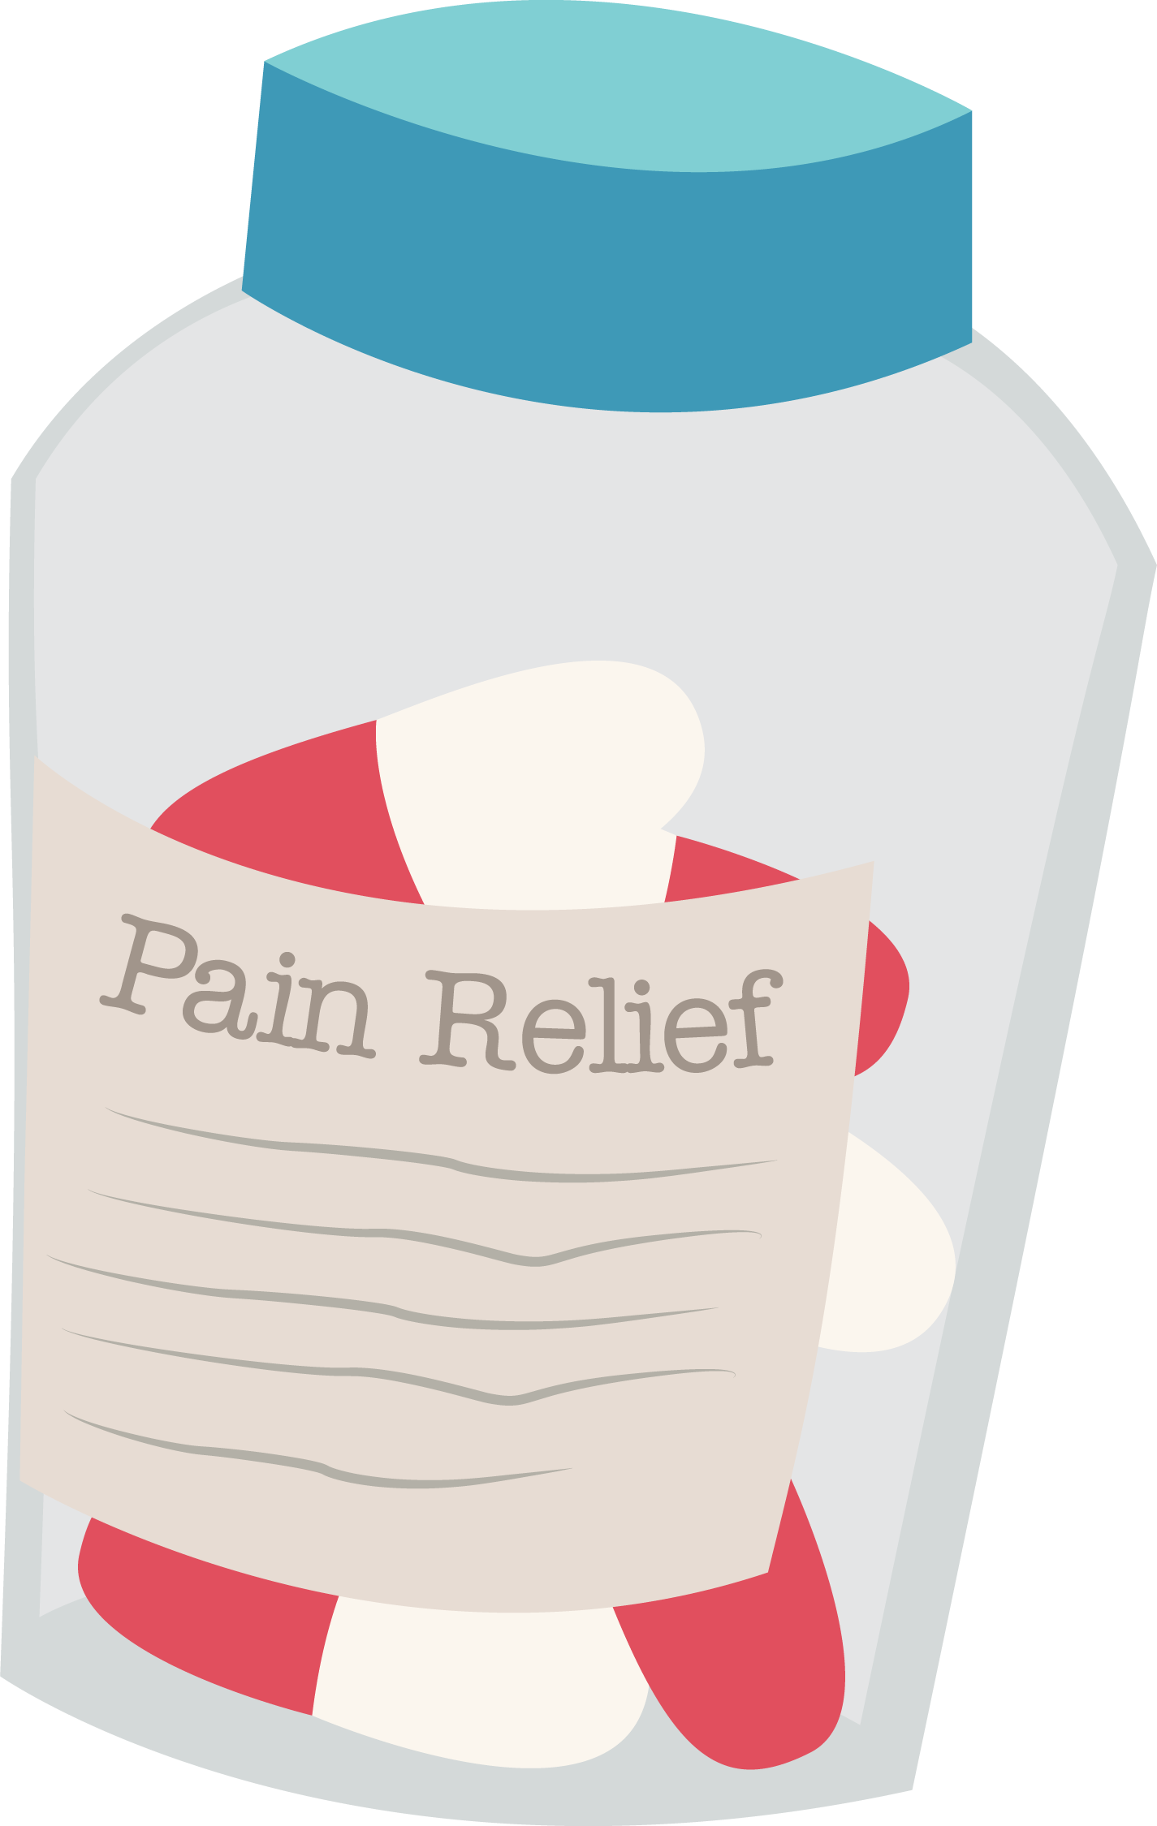

Slide 2
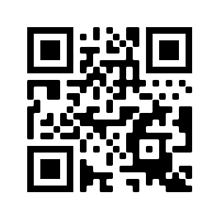
Participant Pre-Survey
Thank you for taking the pre-survey!
Your answers will help in future education about medication safety.
bit.ly/pt2web1

Slide 4
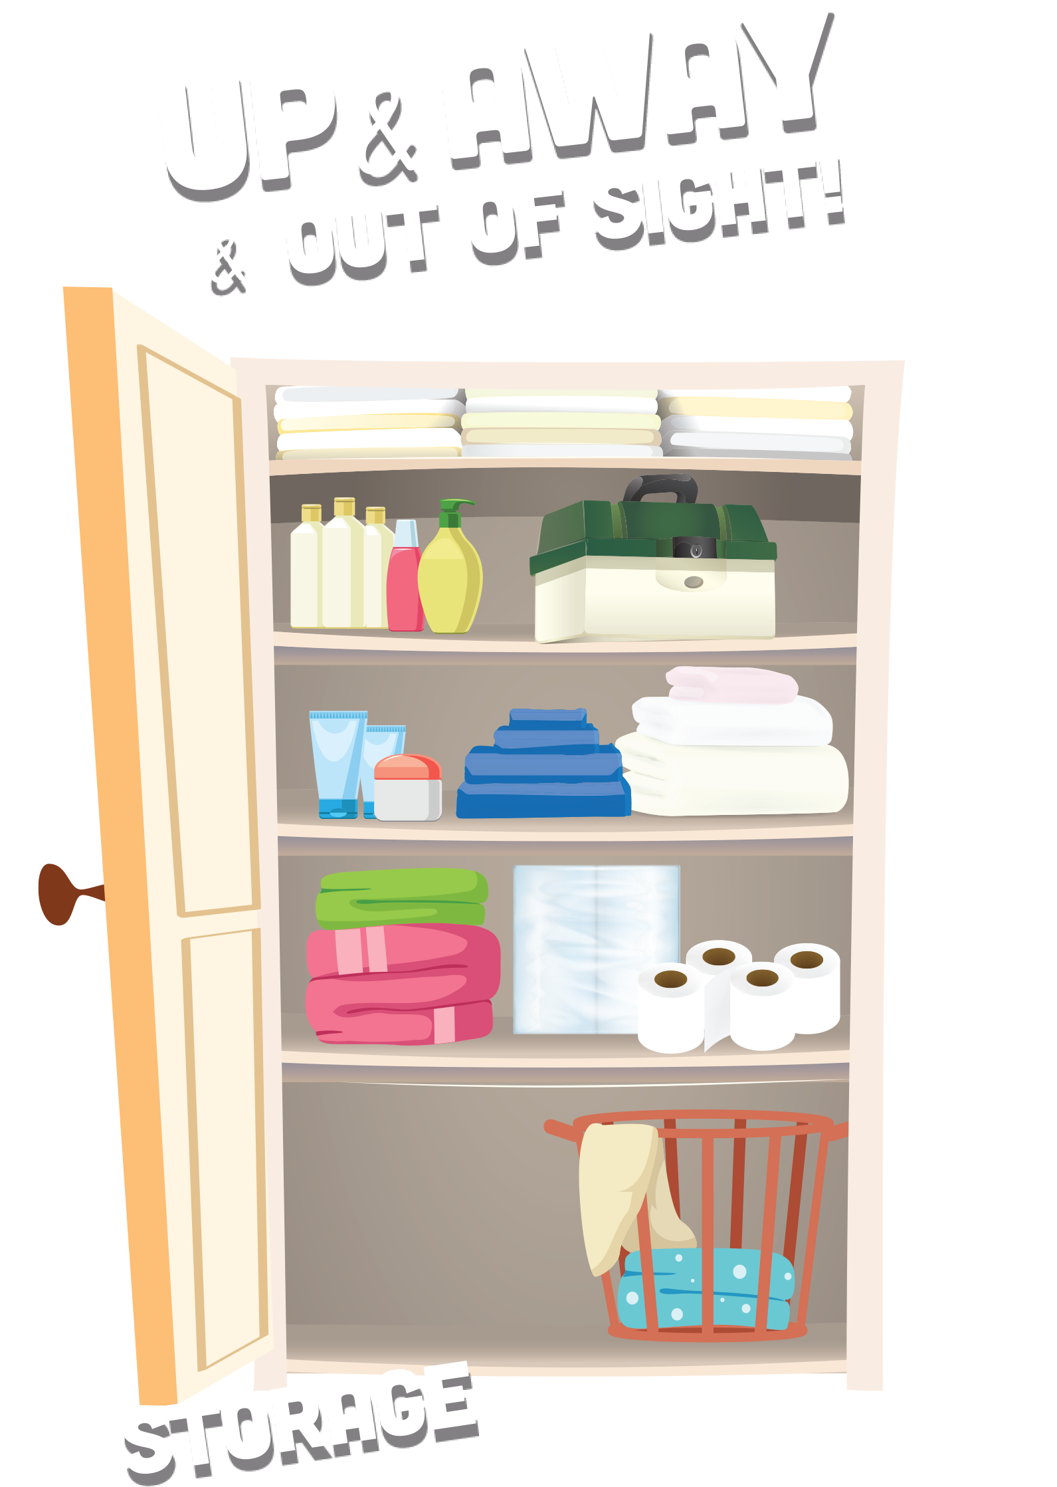
Storing Your Medications
Keep your medications in their original container or packaging
If you can, avoid mixing multiple medications in the same container
Store your medications somewhere cool and dry

Slide 5
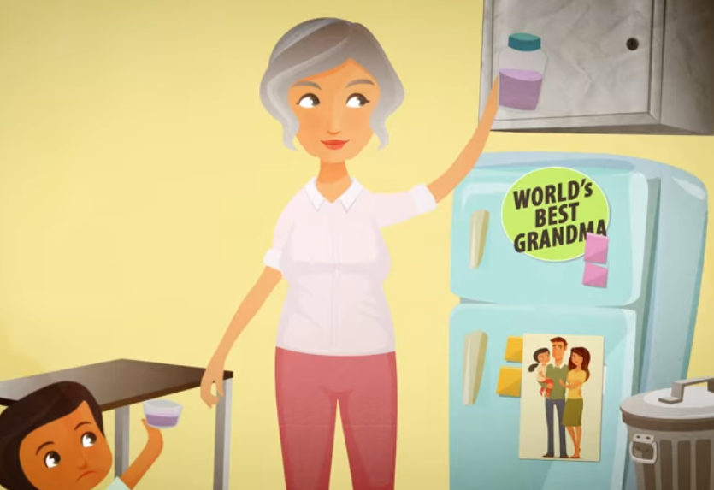
Up and Away and Out of Sight
Store medications up and away and out of sight—maybe on the top shelf of a cabinet or hall closet
Never leave medications out on a table, countertop, or sink, or any spot that is easy for children to access
Consider storing medications in a lockable storage container
Keep purses, bags, and coats that contain medications up and away, and out of reach at home and when visiting others
Relock safety caps tightly

Slide 7
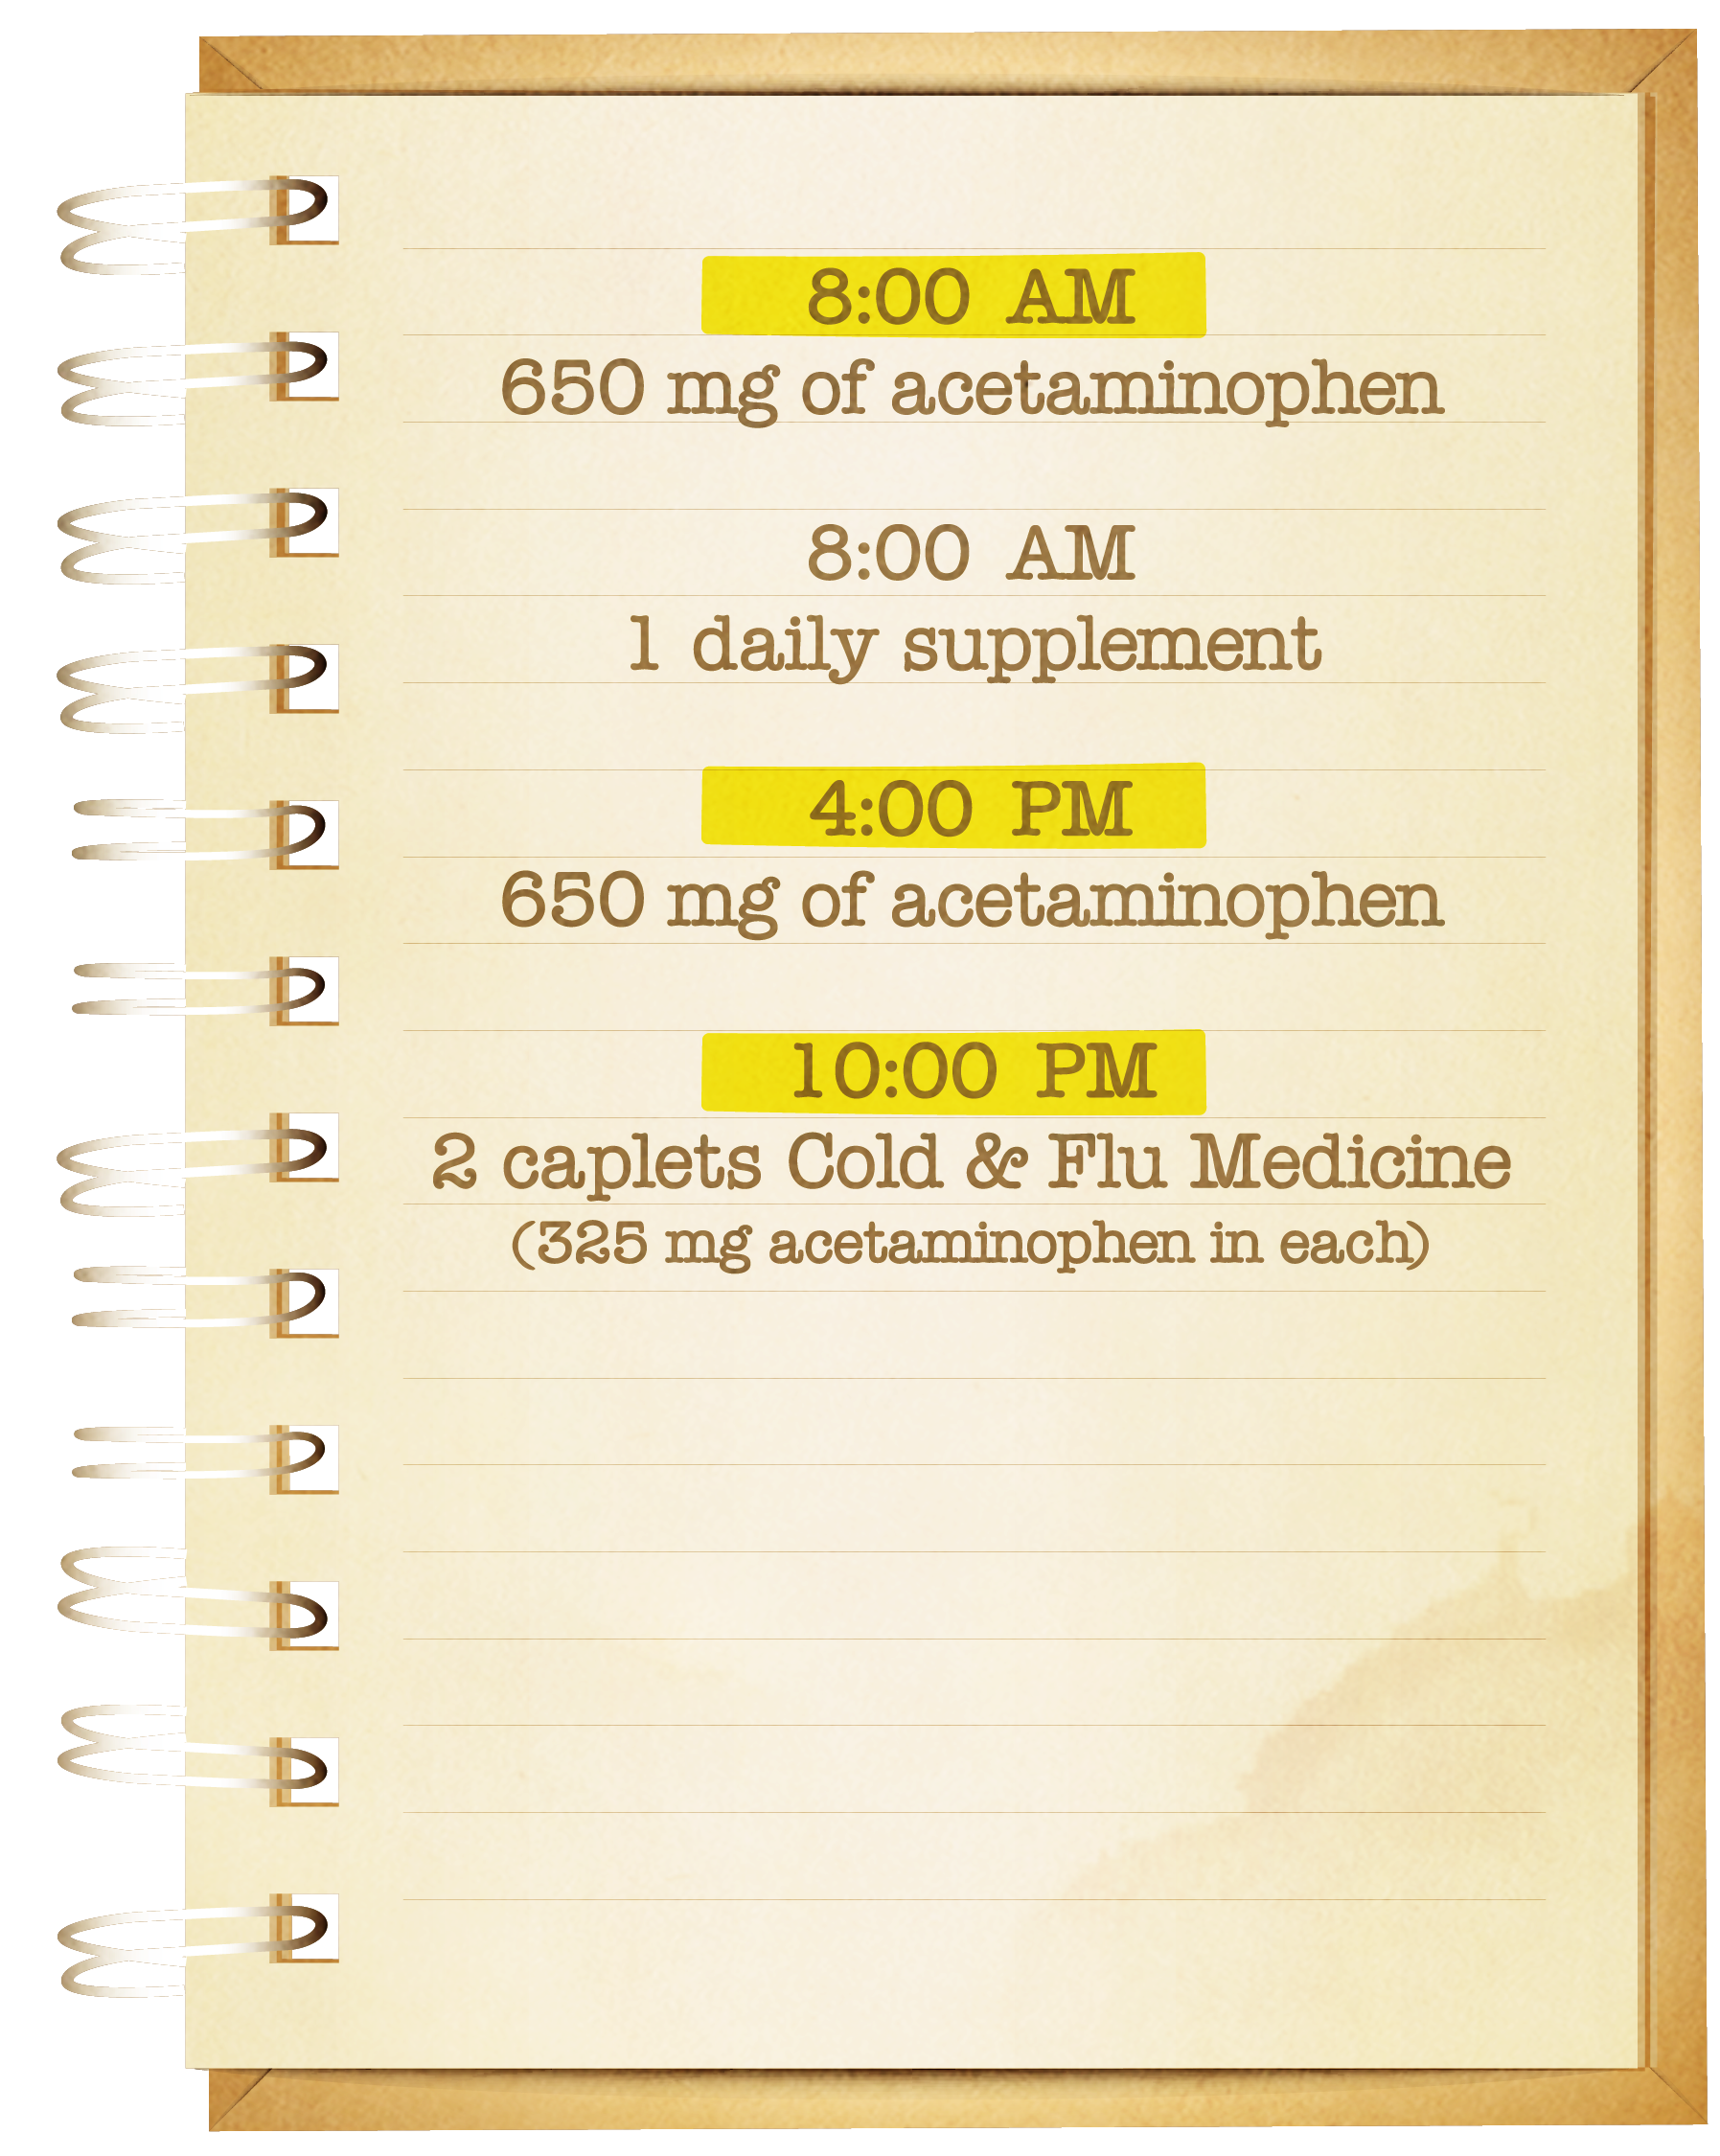
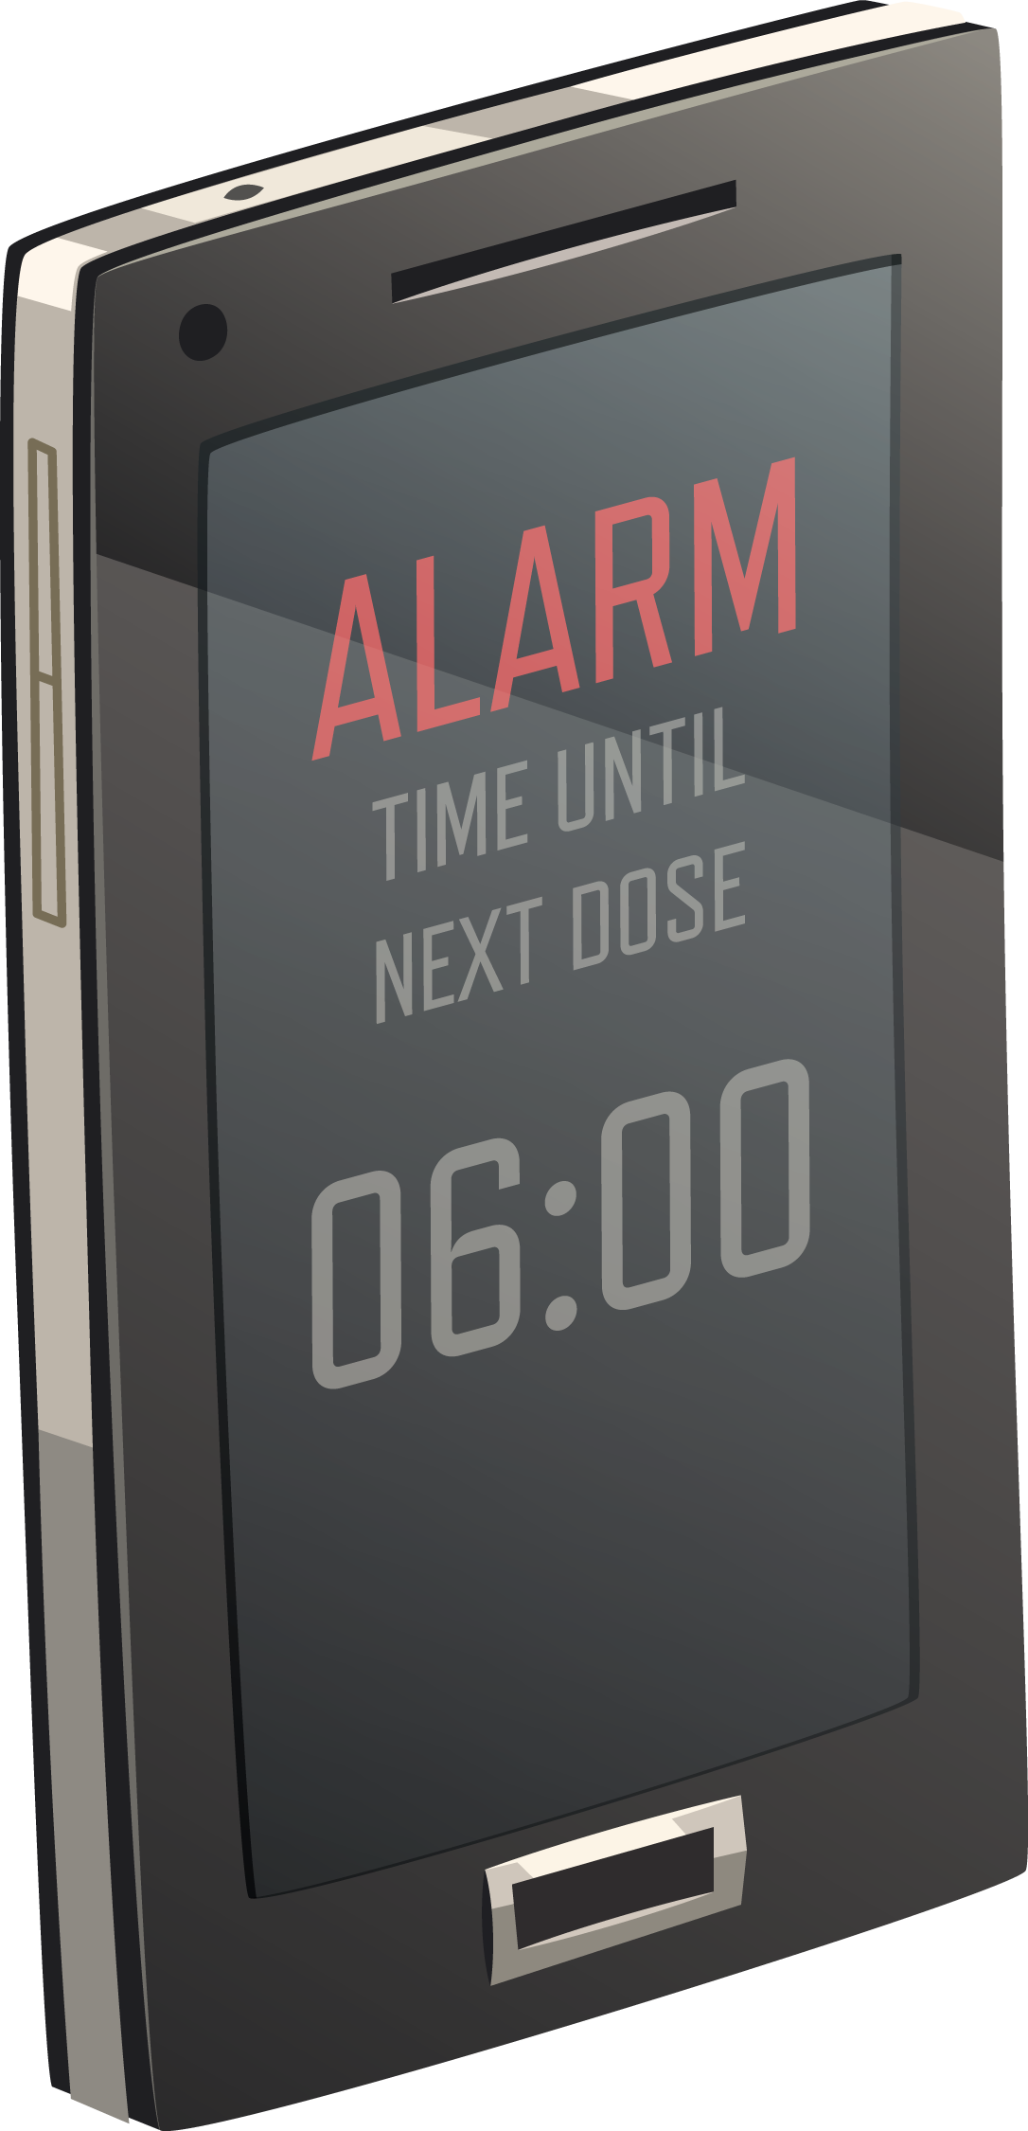
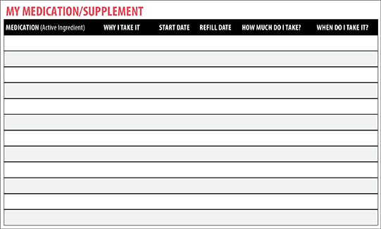
Keeping Track of Your Medications

Slide 8
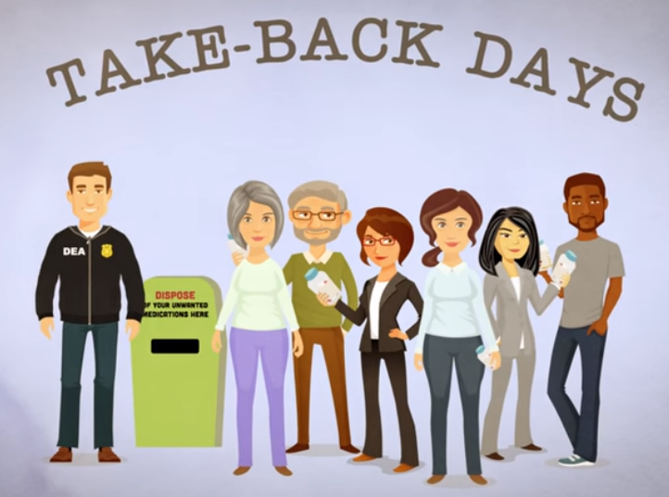
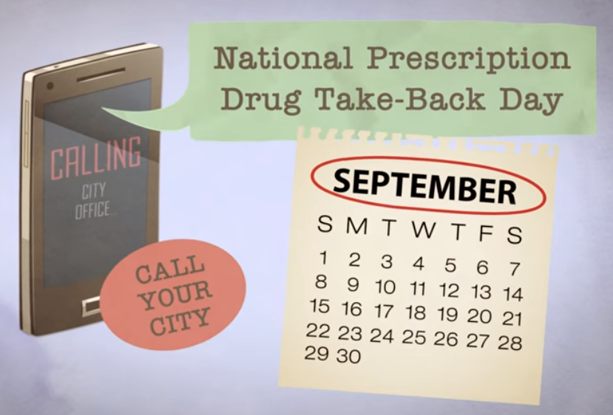
Disposing of Medications

Slide 9
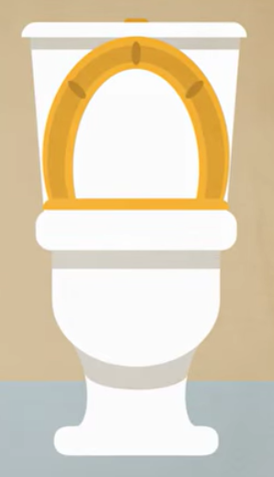
FDA’s Flush List for Certain Medications
If you can’t get to a drug take back site to dispose of your medications, check to see if your medication is on the Flush List
The Flush List includes medications that:
1) Are sought-after for their misuse and/or abuse potential
2) Can result in death from one dose if taken inappropriately
Flushing medicines on the Flush List helps keep everyone at home safe
Don’t flush your medication unless it is on the Flush List

Slide 10
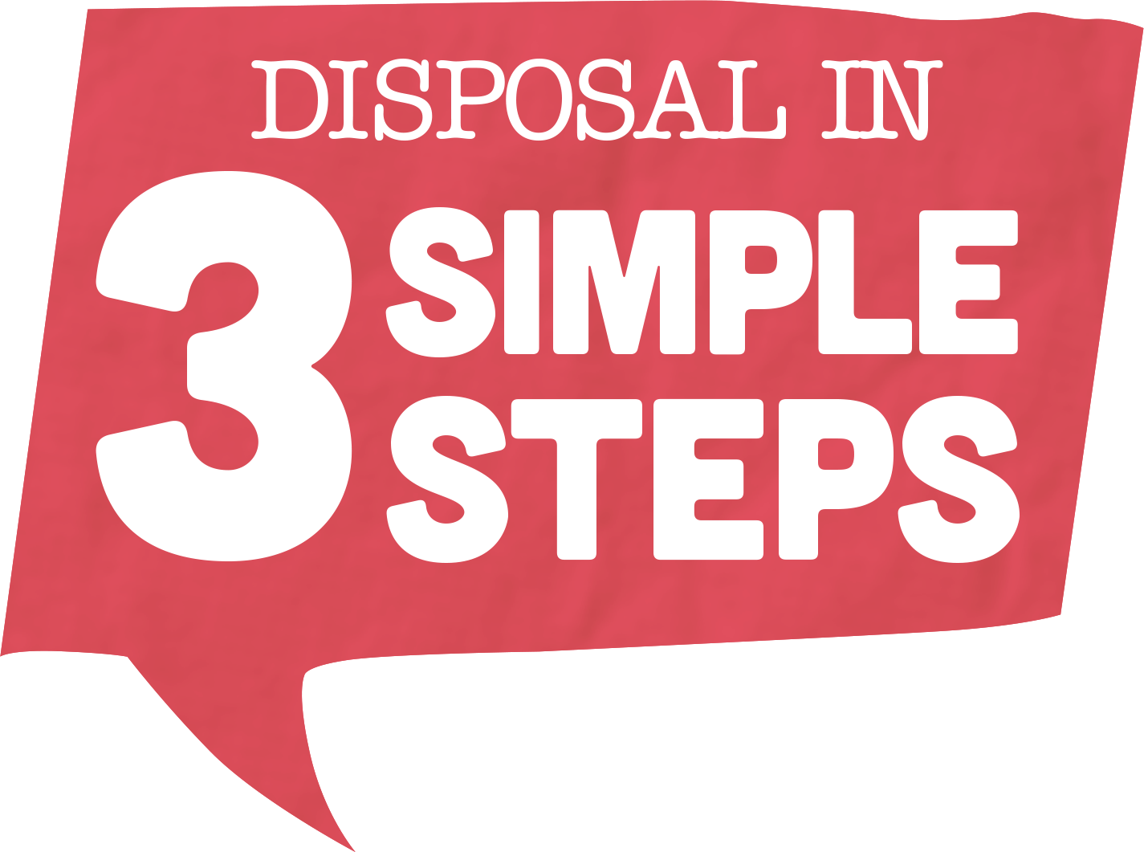
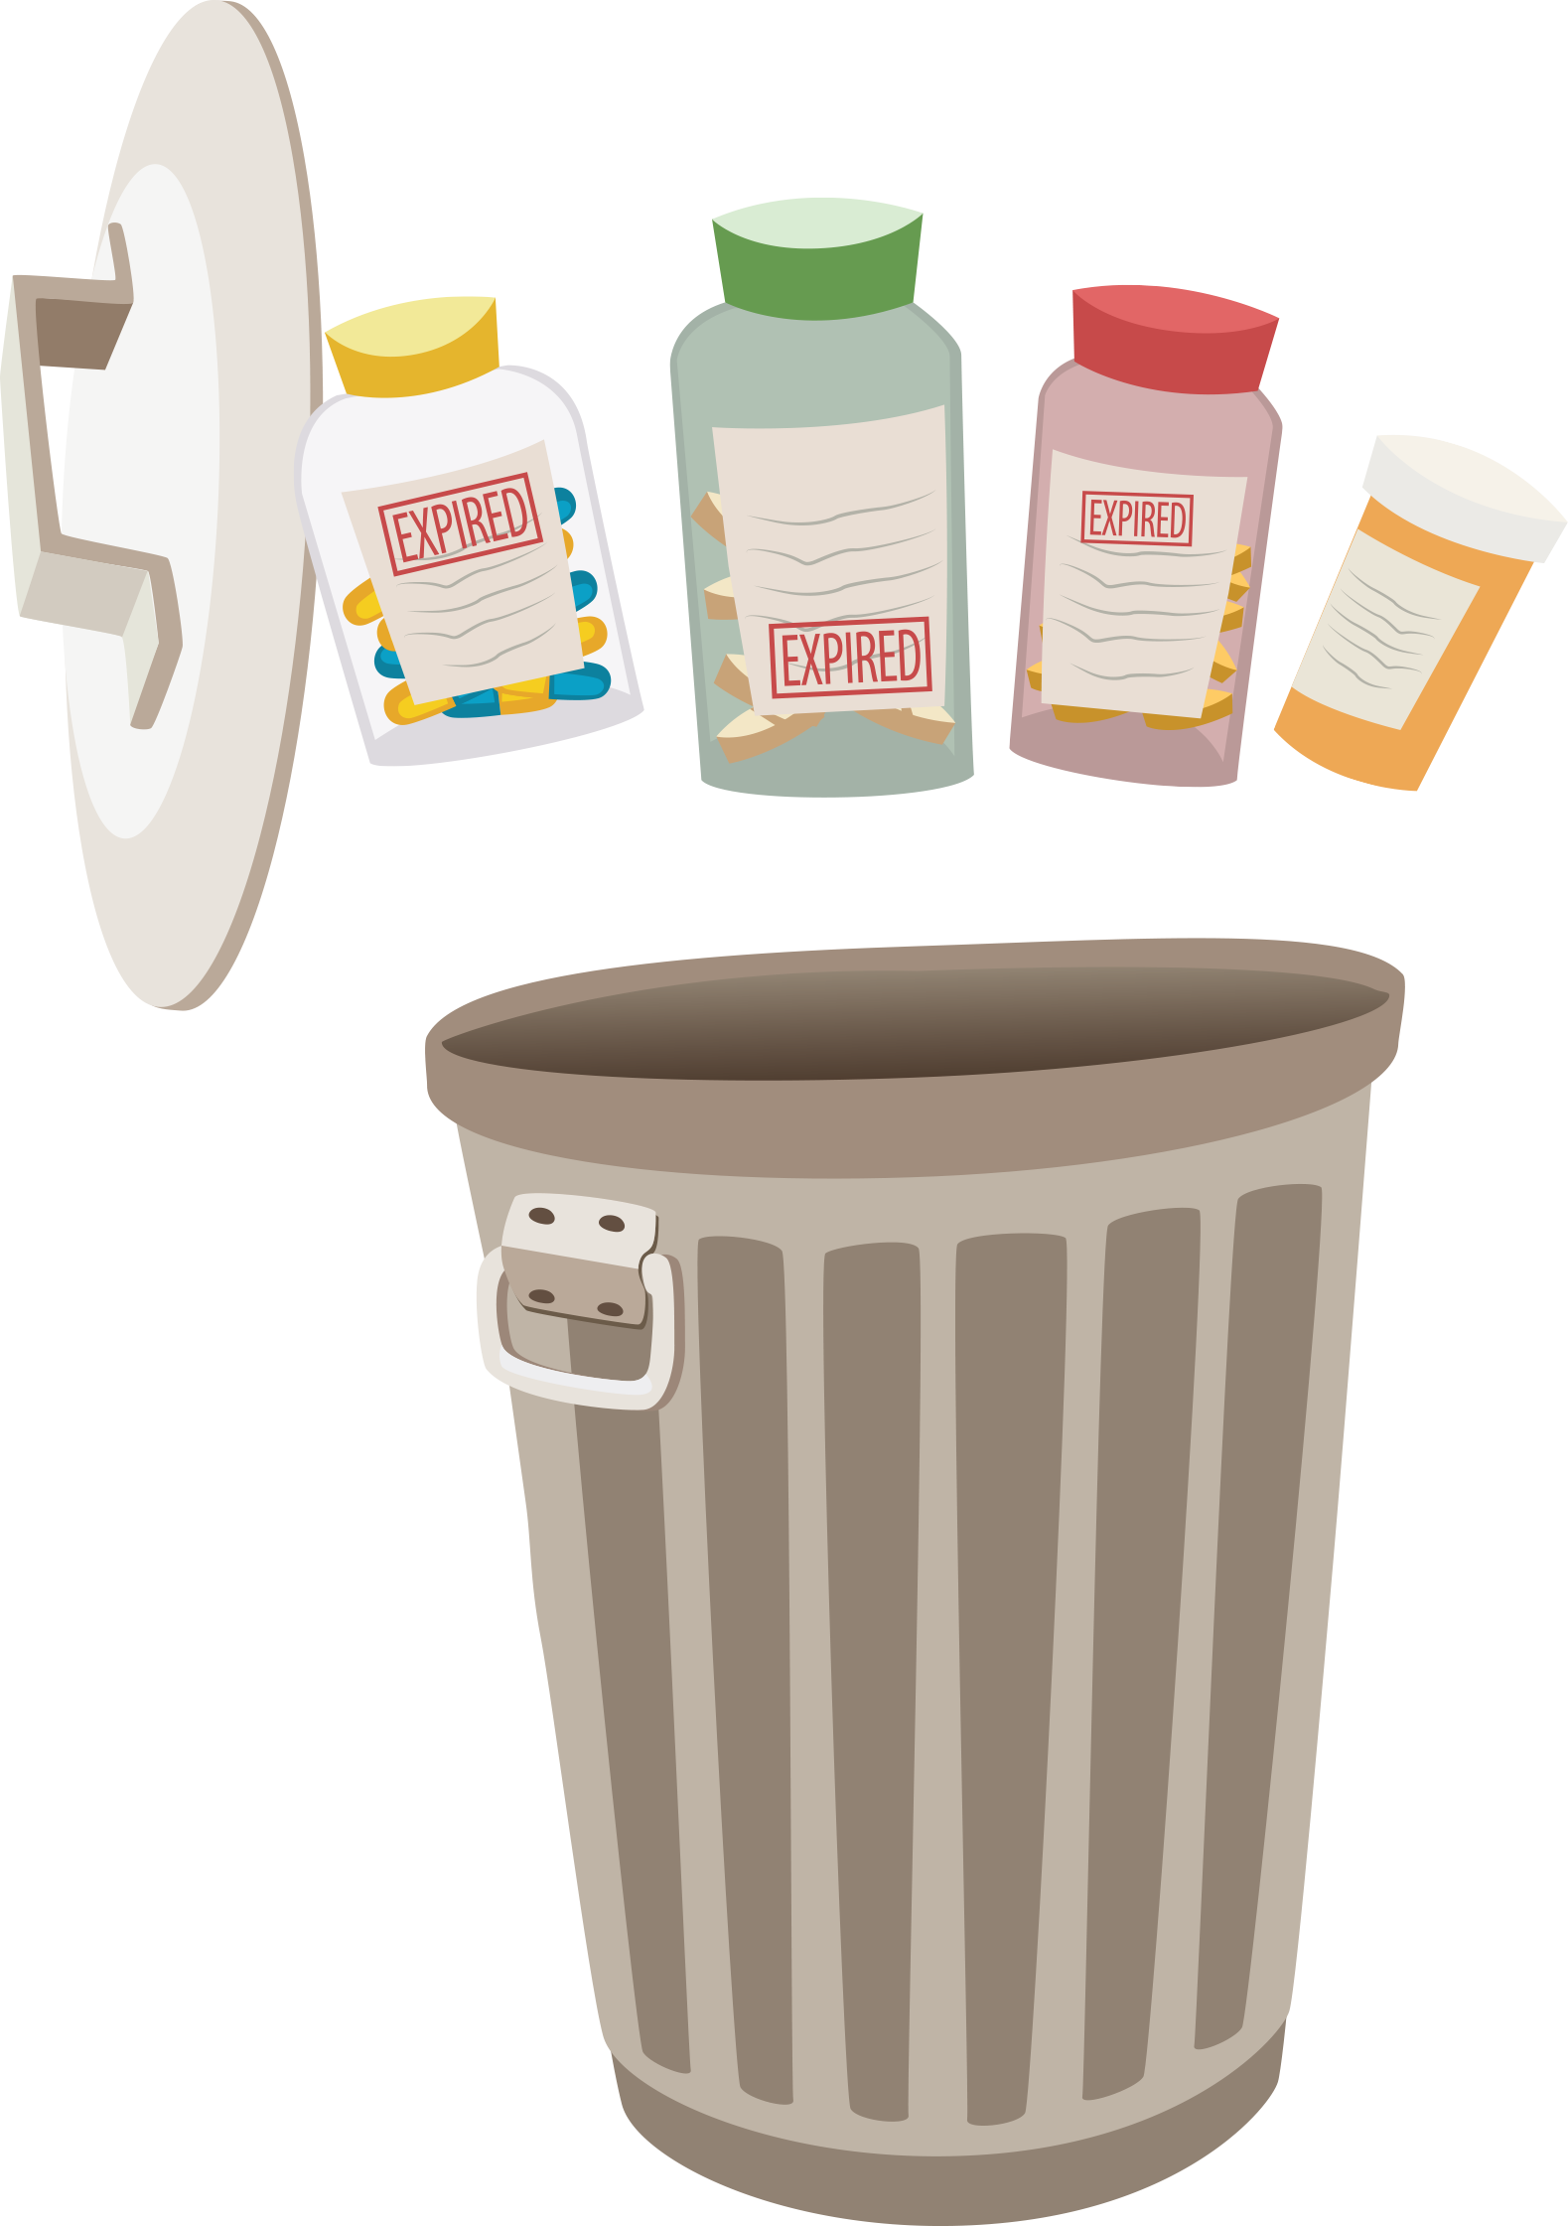
Throw Away Medications in 3 Easy Steps

Slide 11
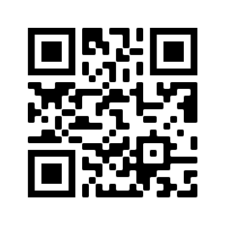
What Have We Learned?
Please take a few minutes to take the post-survey that will help the workshop creators understand how effective the resources are.
bit.ly/pt2web2
Remember that your answers are anonymous!

Slide 12
For questions or comments, contact: The Alliance for Aging Research 202-239-2856 info@agingresearch.org
With Support From:

